Slide 1
Concept Check #3
Mean, median, dot plot

Slide 2
1st Quiz Tomorrow
Review all pages we learned this week.
(15 minutes)

Slide 3




Rules

Slide 4
Lesson 3
Estimating Centers
Interpreting the Mean as a Balance Point
估算中心
将平均值解释为平衡点
Page 17-23

Slide 5
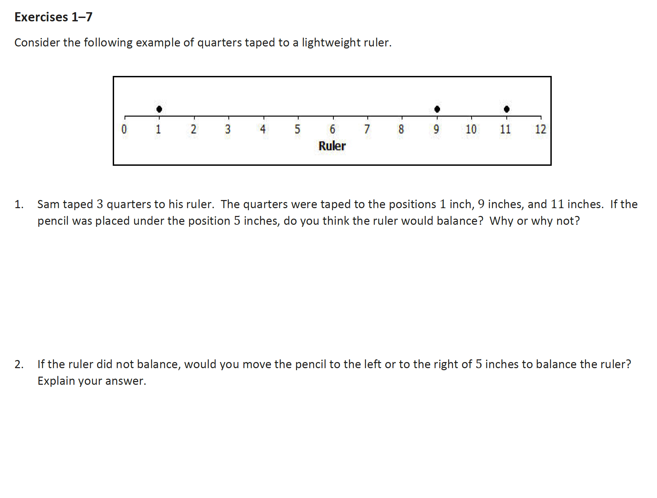

Slide 6
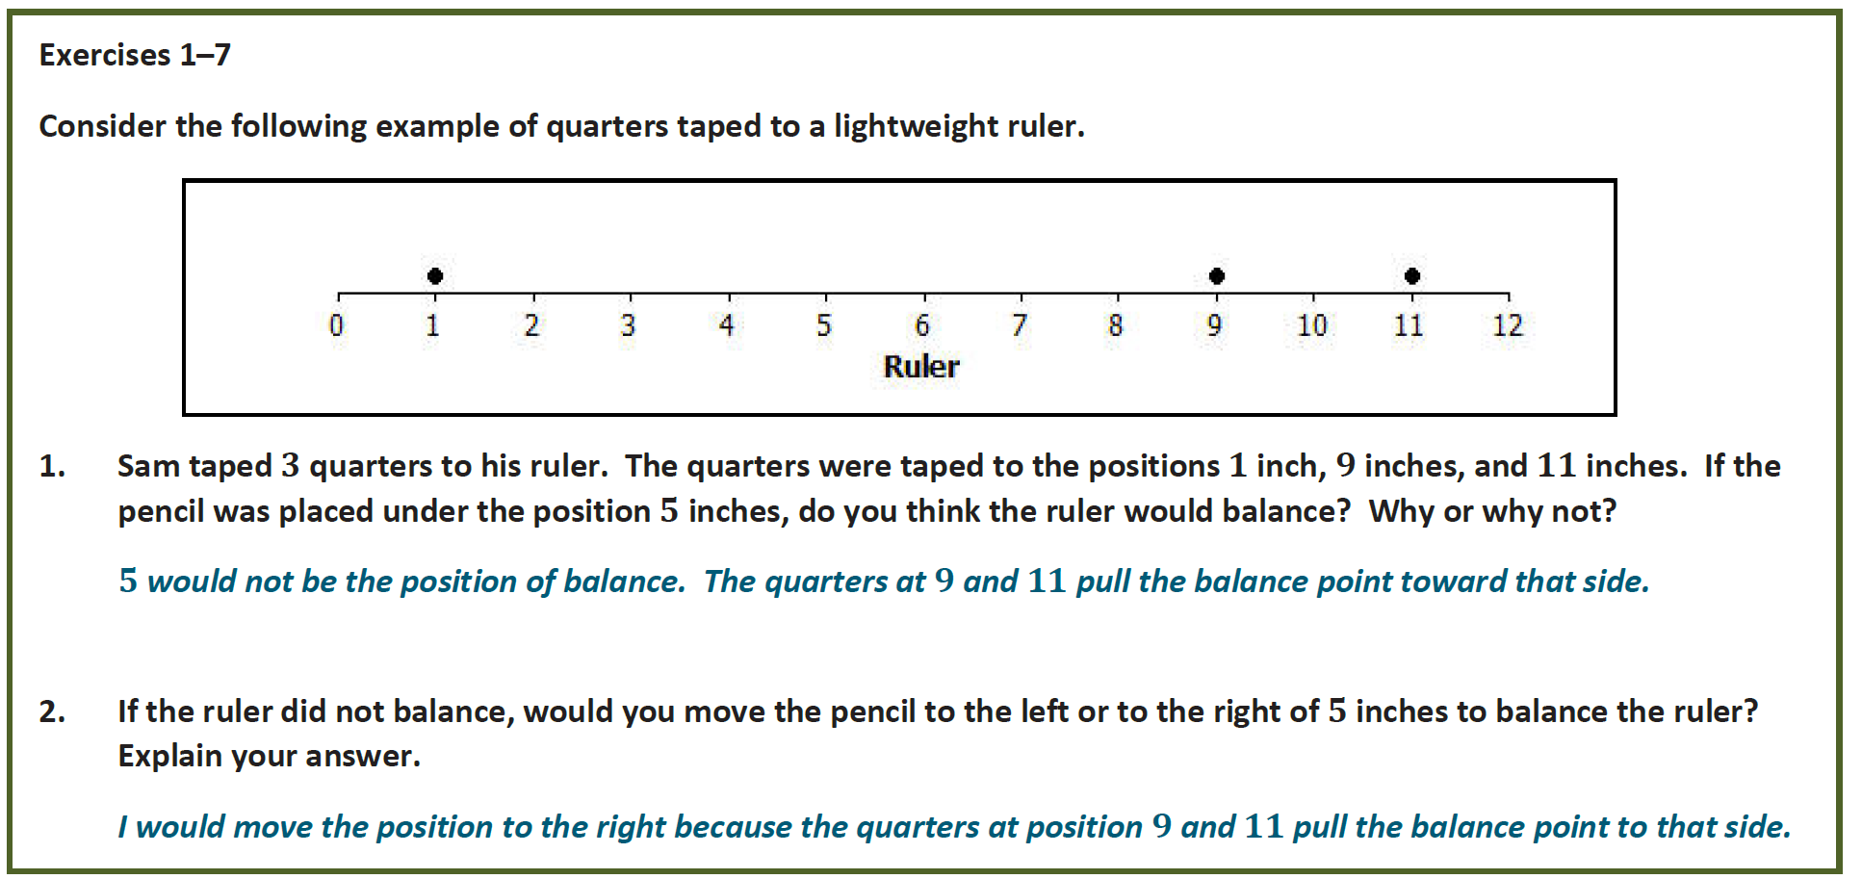

Slide 7
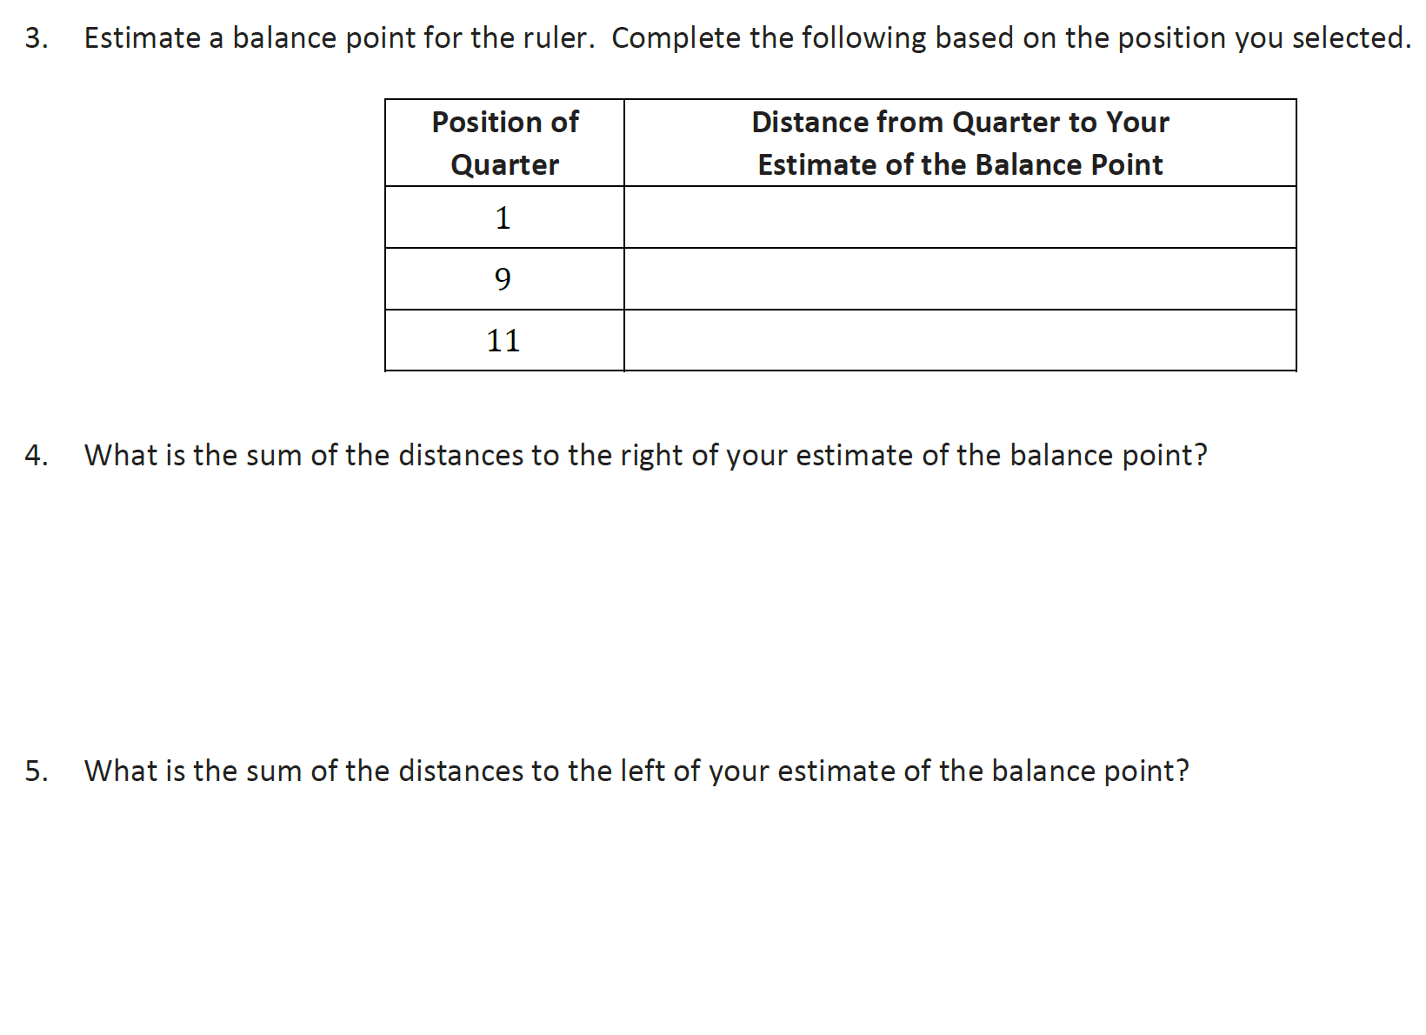

Slide 8
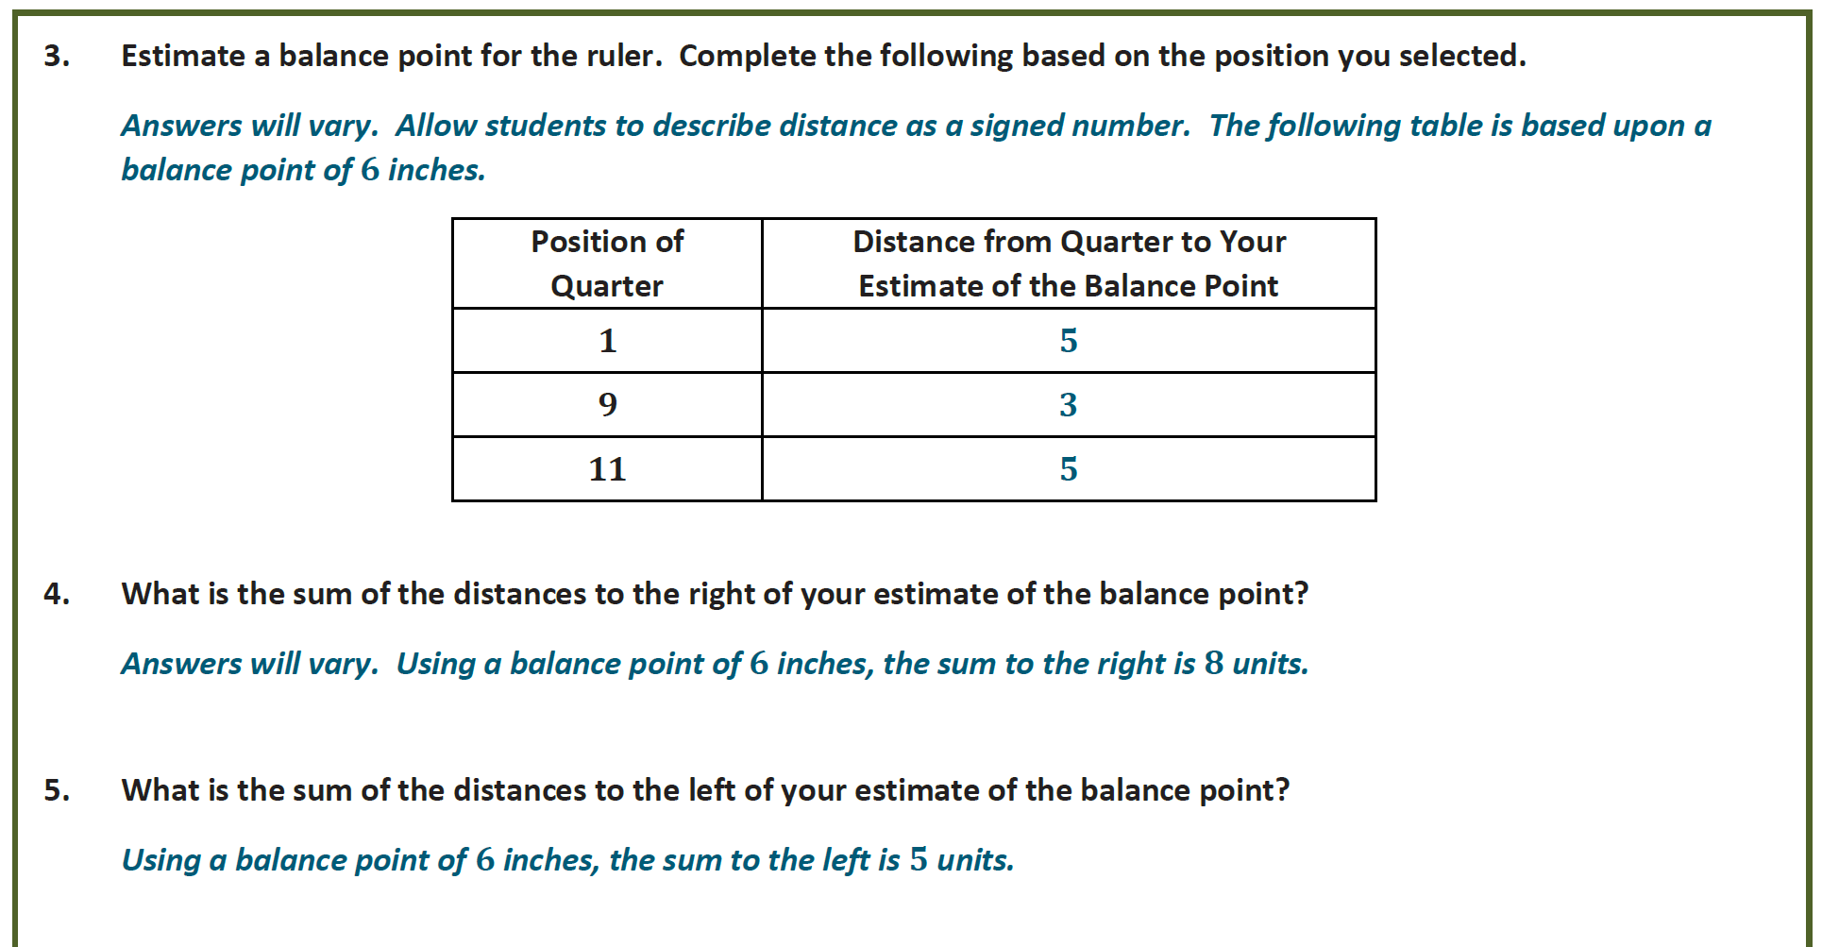

Slide 9
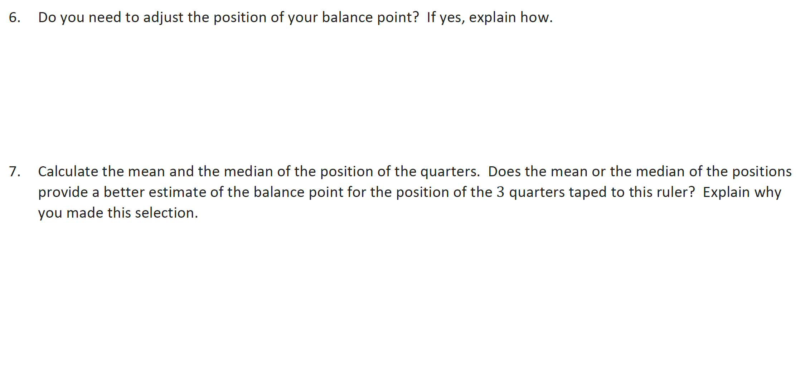

Slide 10
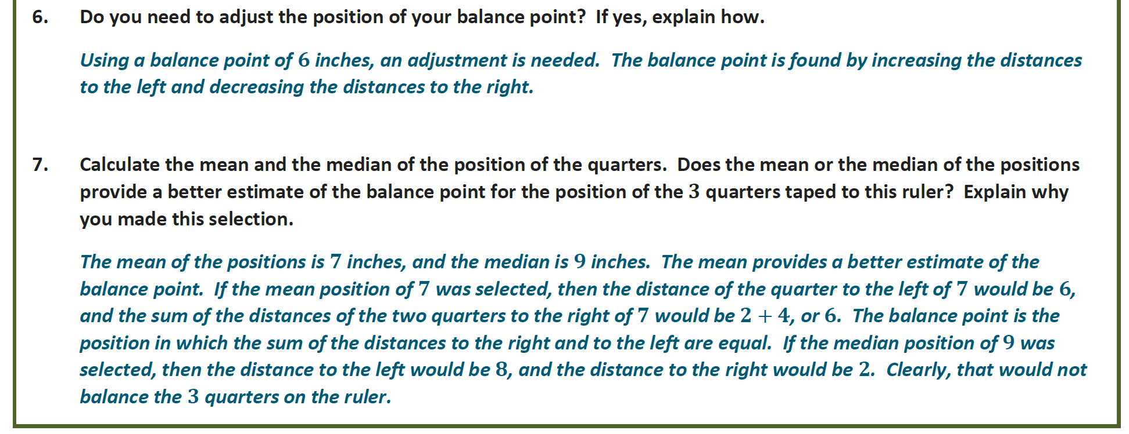

Slide 11
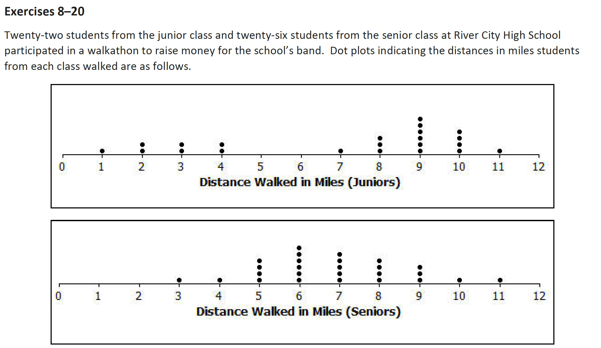

Slide 12
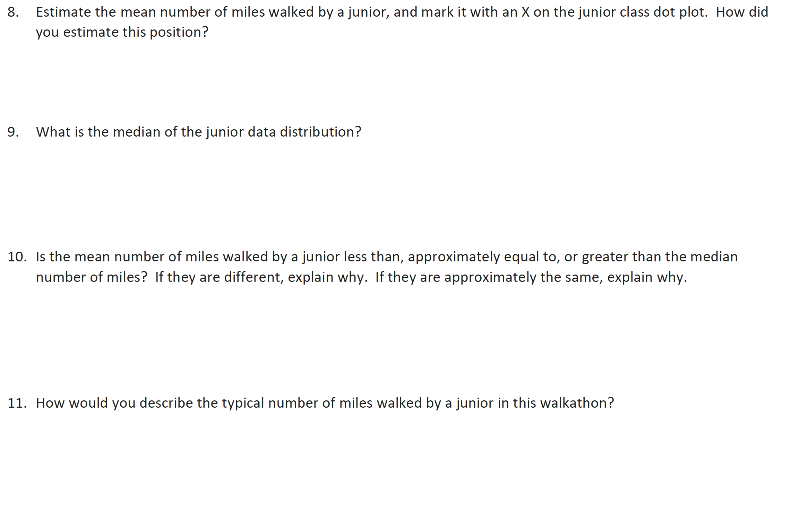

Slide 13
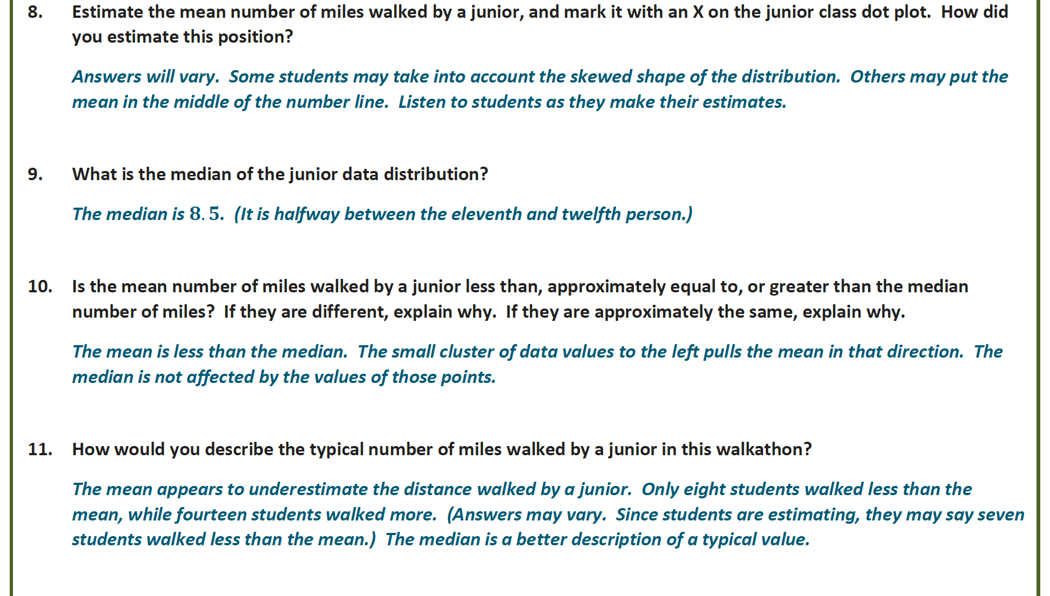
6.59

Slide 14
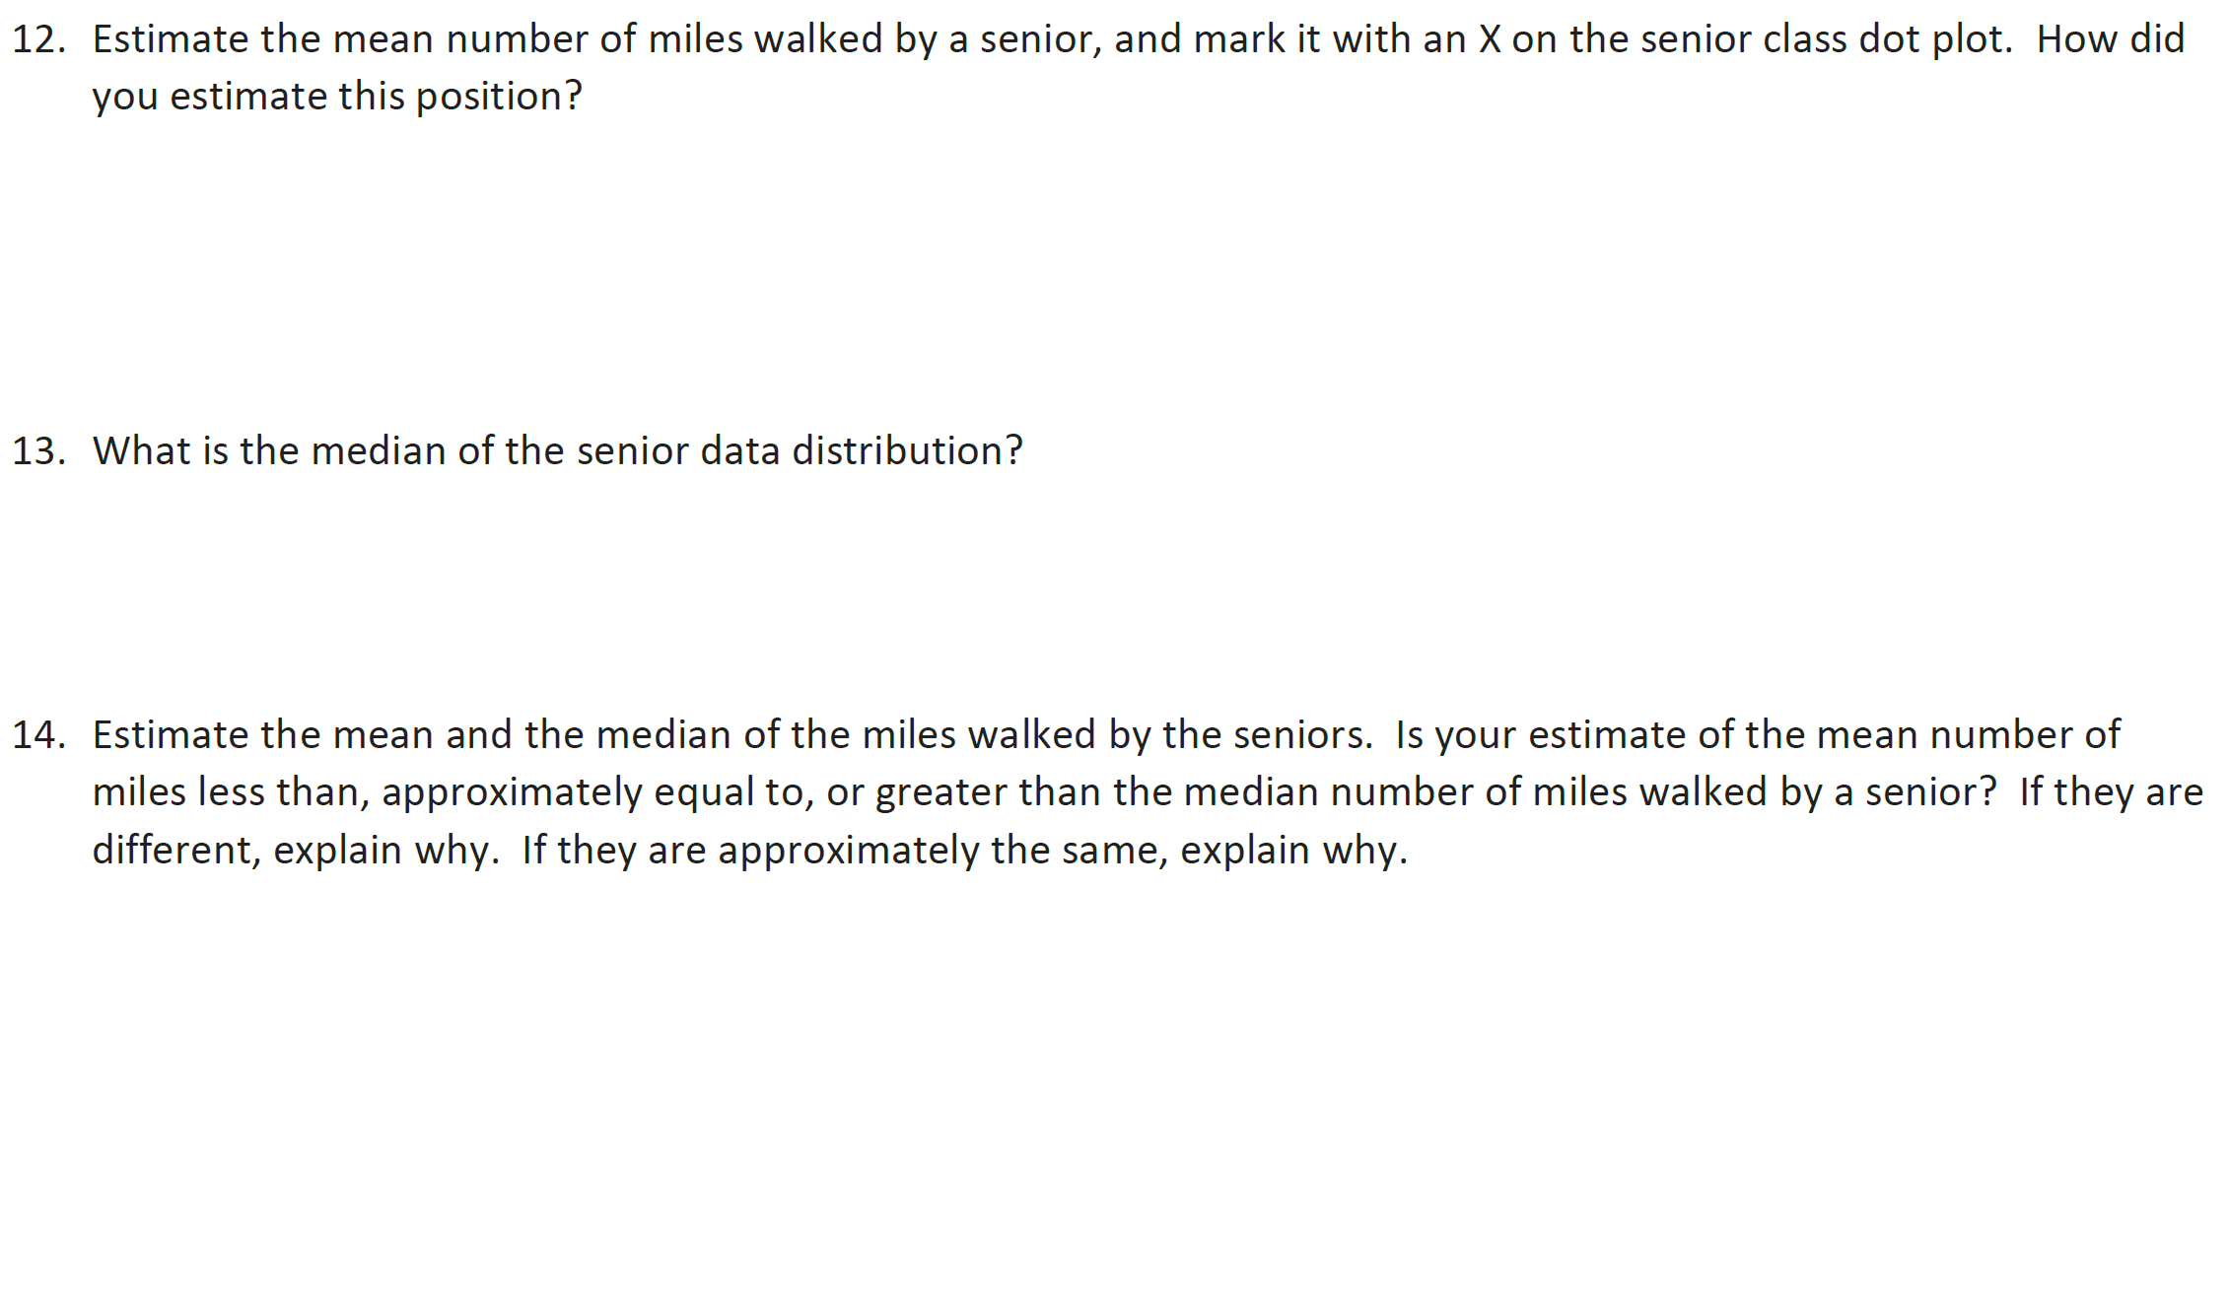

Slide 15



Slide 16
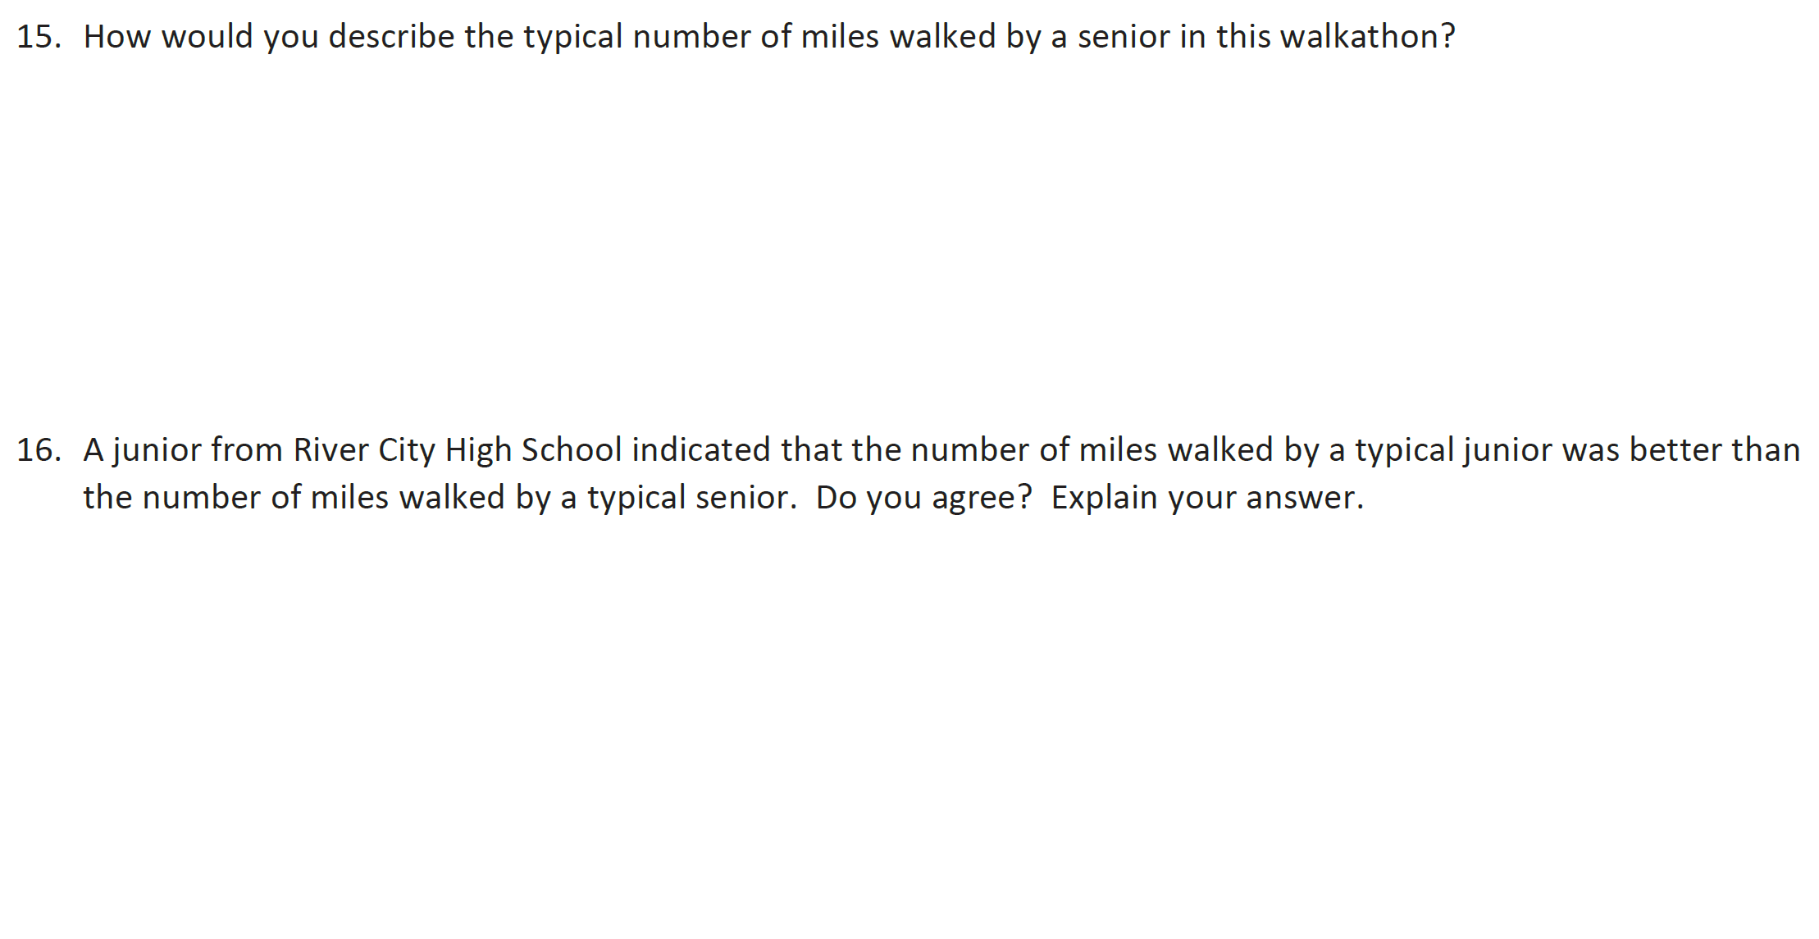

Slide 17


Slide 18
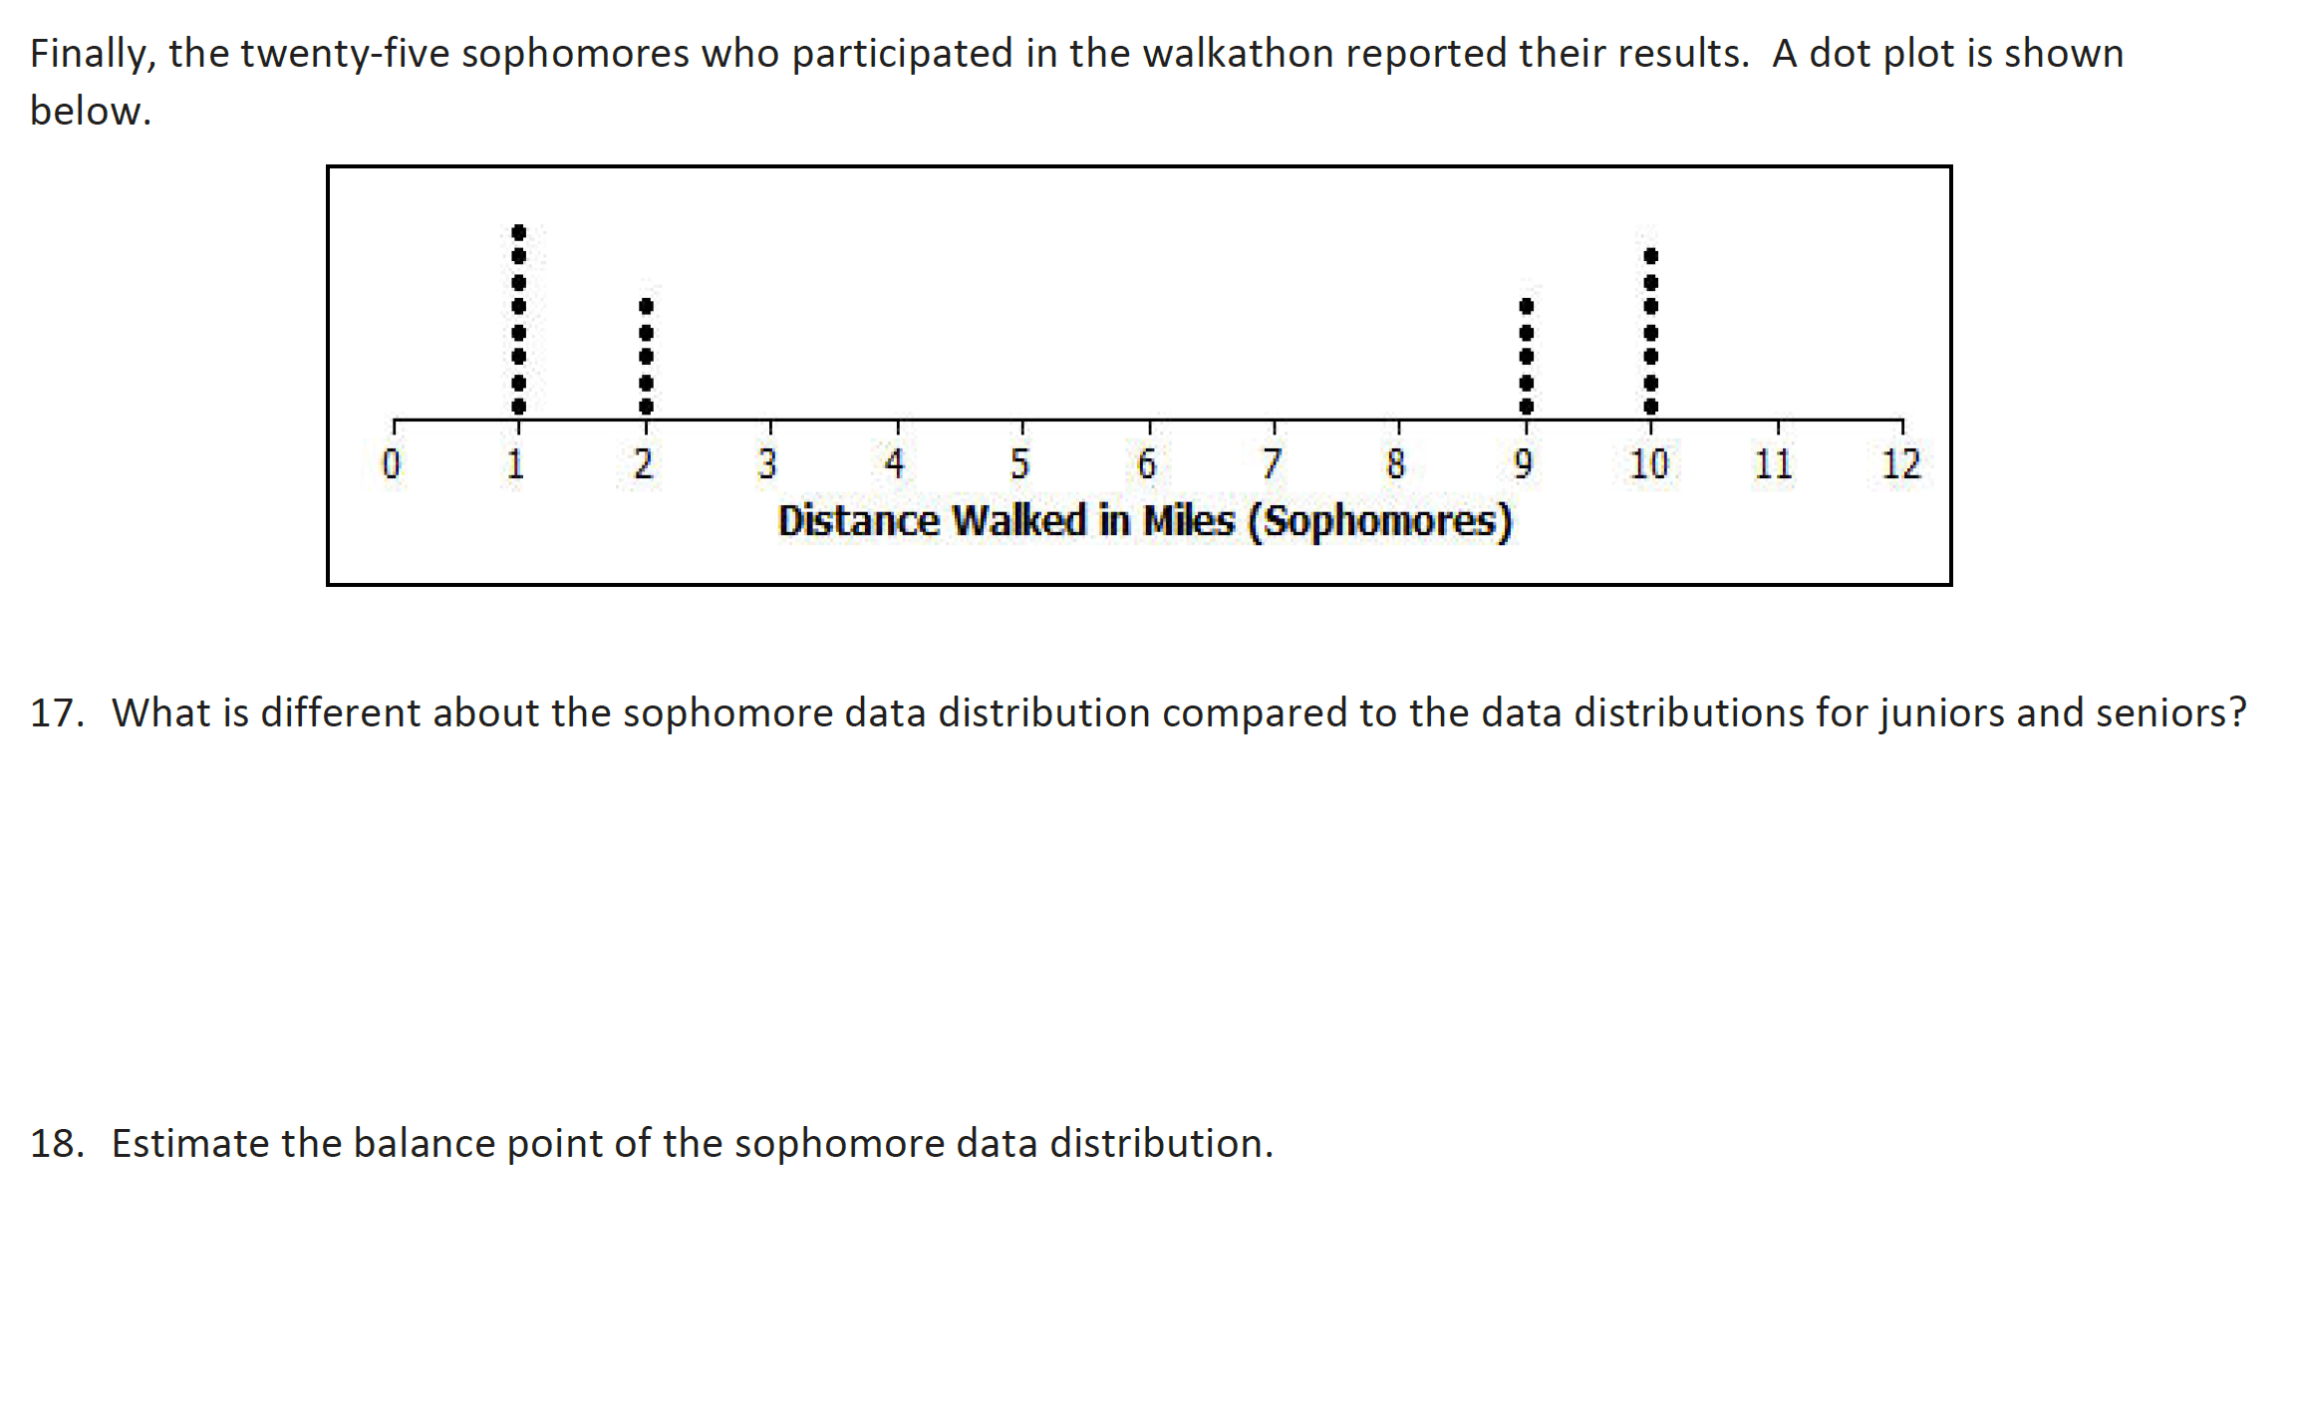

Slide 19


Slide 20
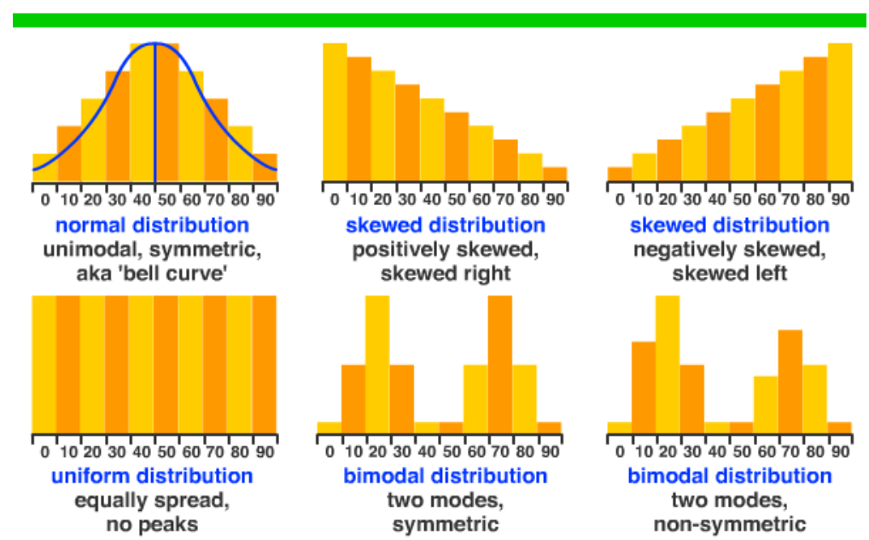
Shape of a Distribution

Slide 22


Slide 23
Assignment
Page 22-23

Slide 24
Lesson 4
Summarizing Deviations from the Mean
从平均值总结偏离的情况
Page 29-30

Slide 26
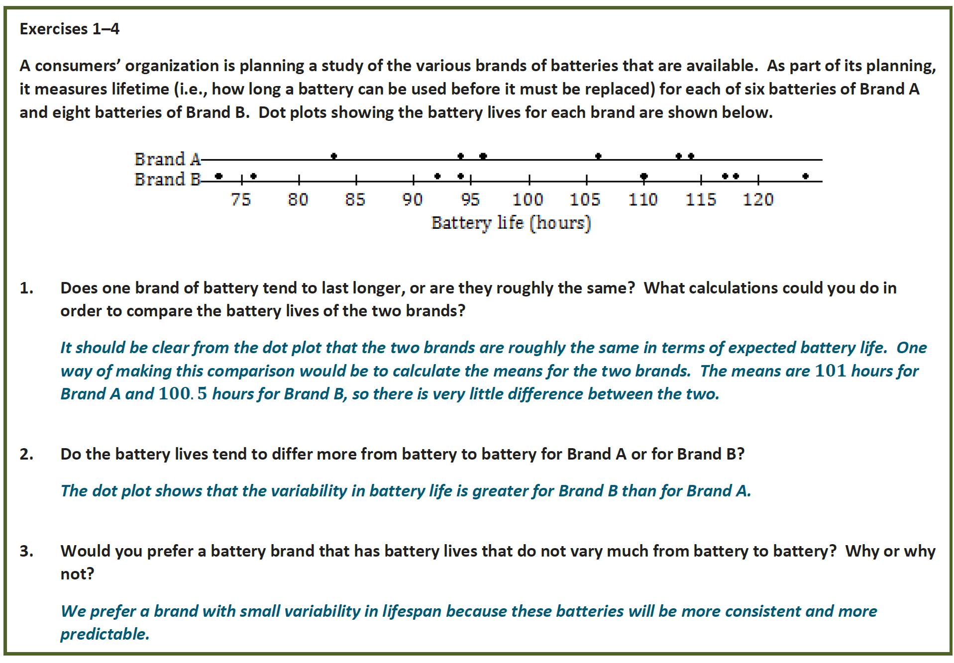

Slide 30


Slide 31
[ˌveriəˈbɪləti]

Slide 32
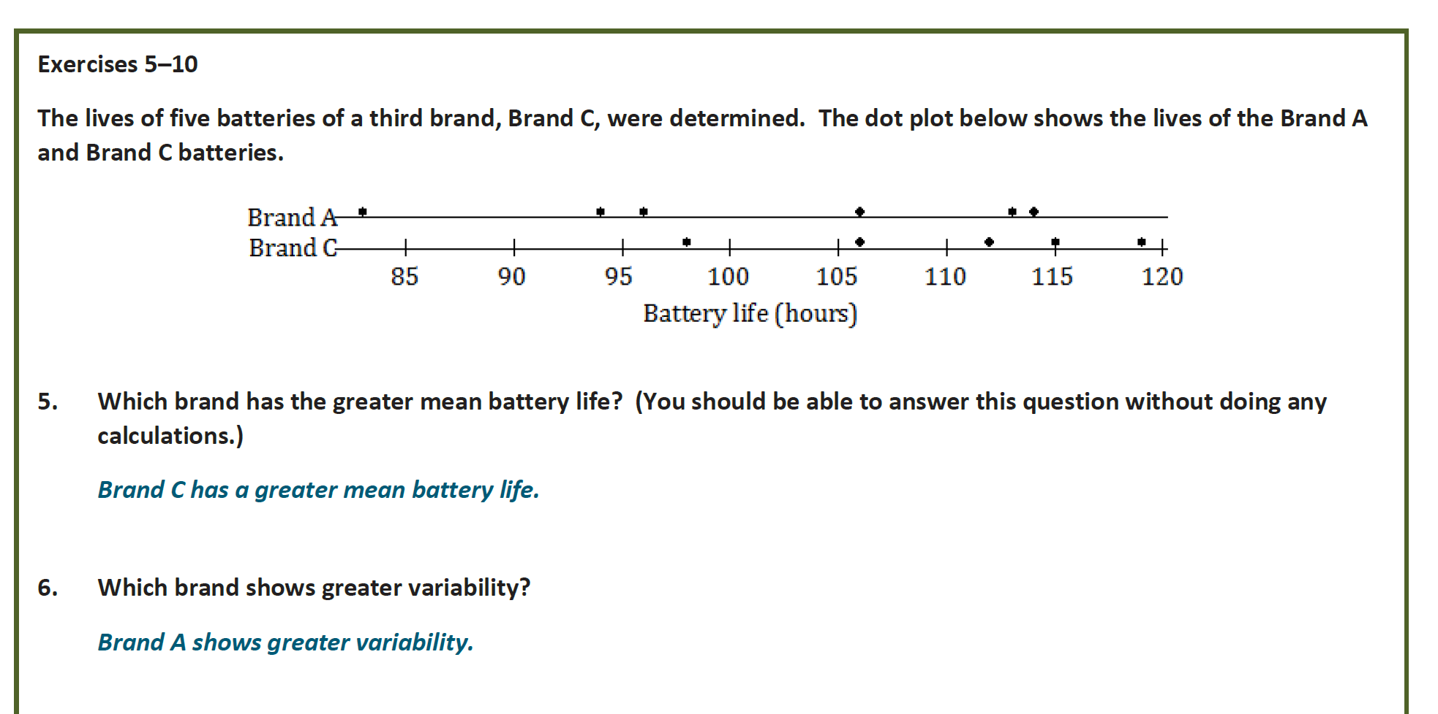

Slide 34
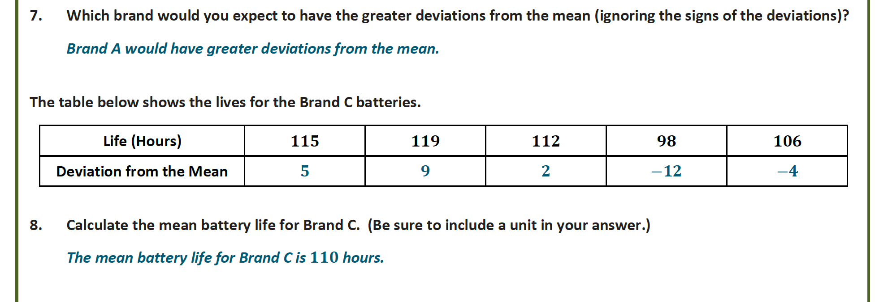

Slide 36


Slide 37
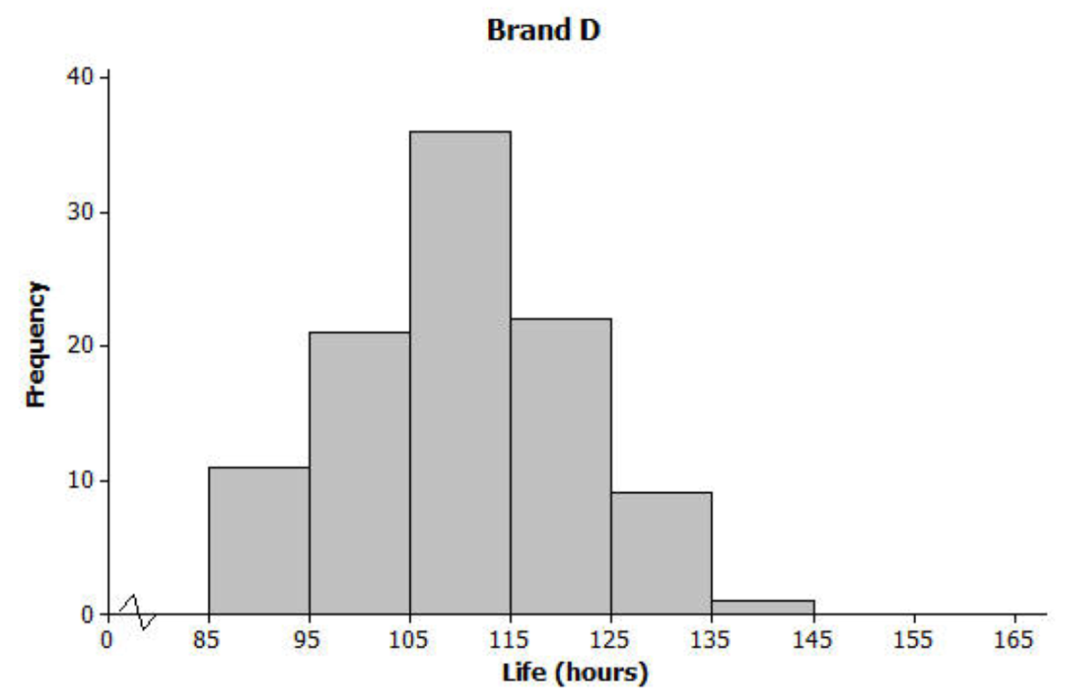

Slide 38
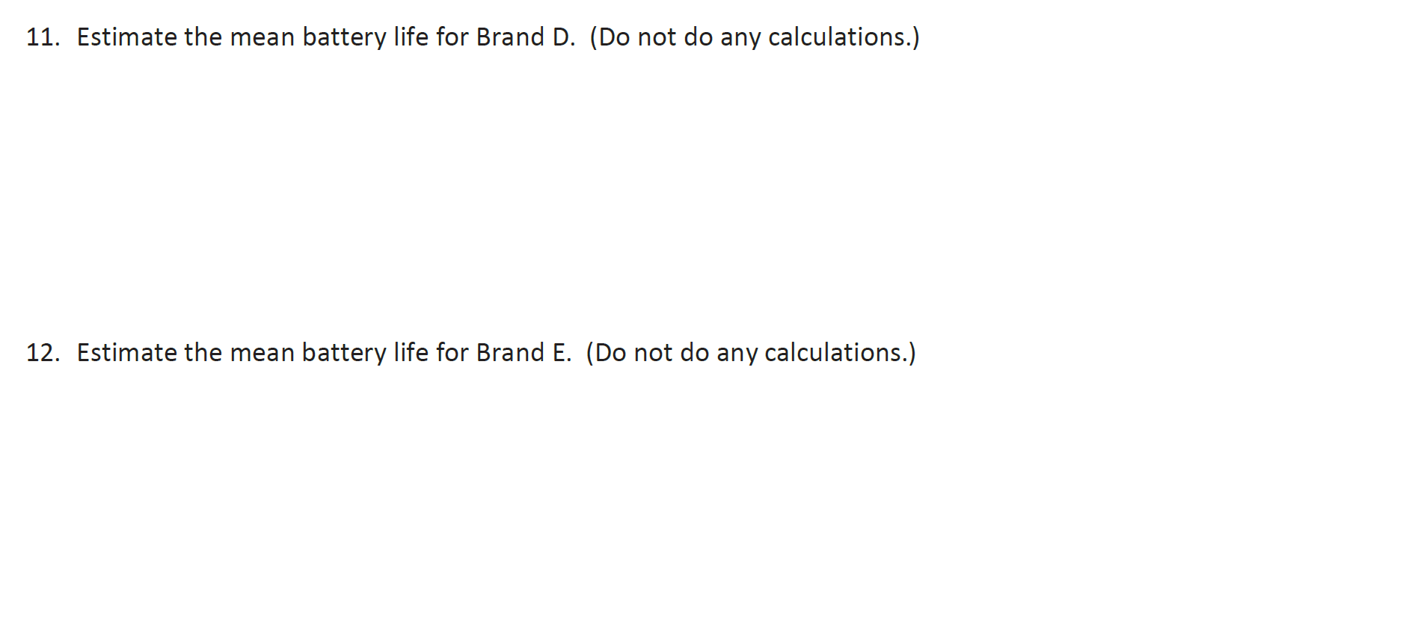

Slide 39


Slide 41


Slide 42
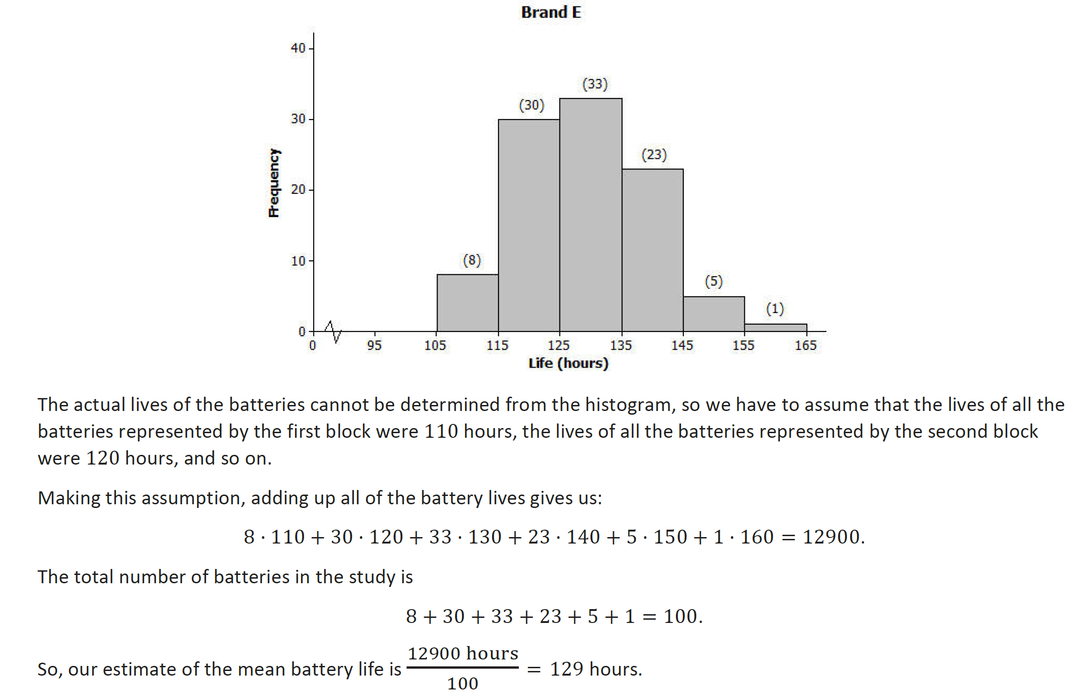

Slide 43
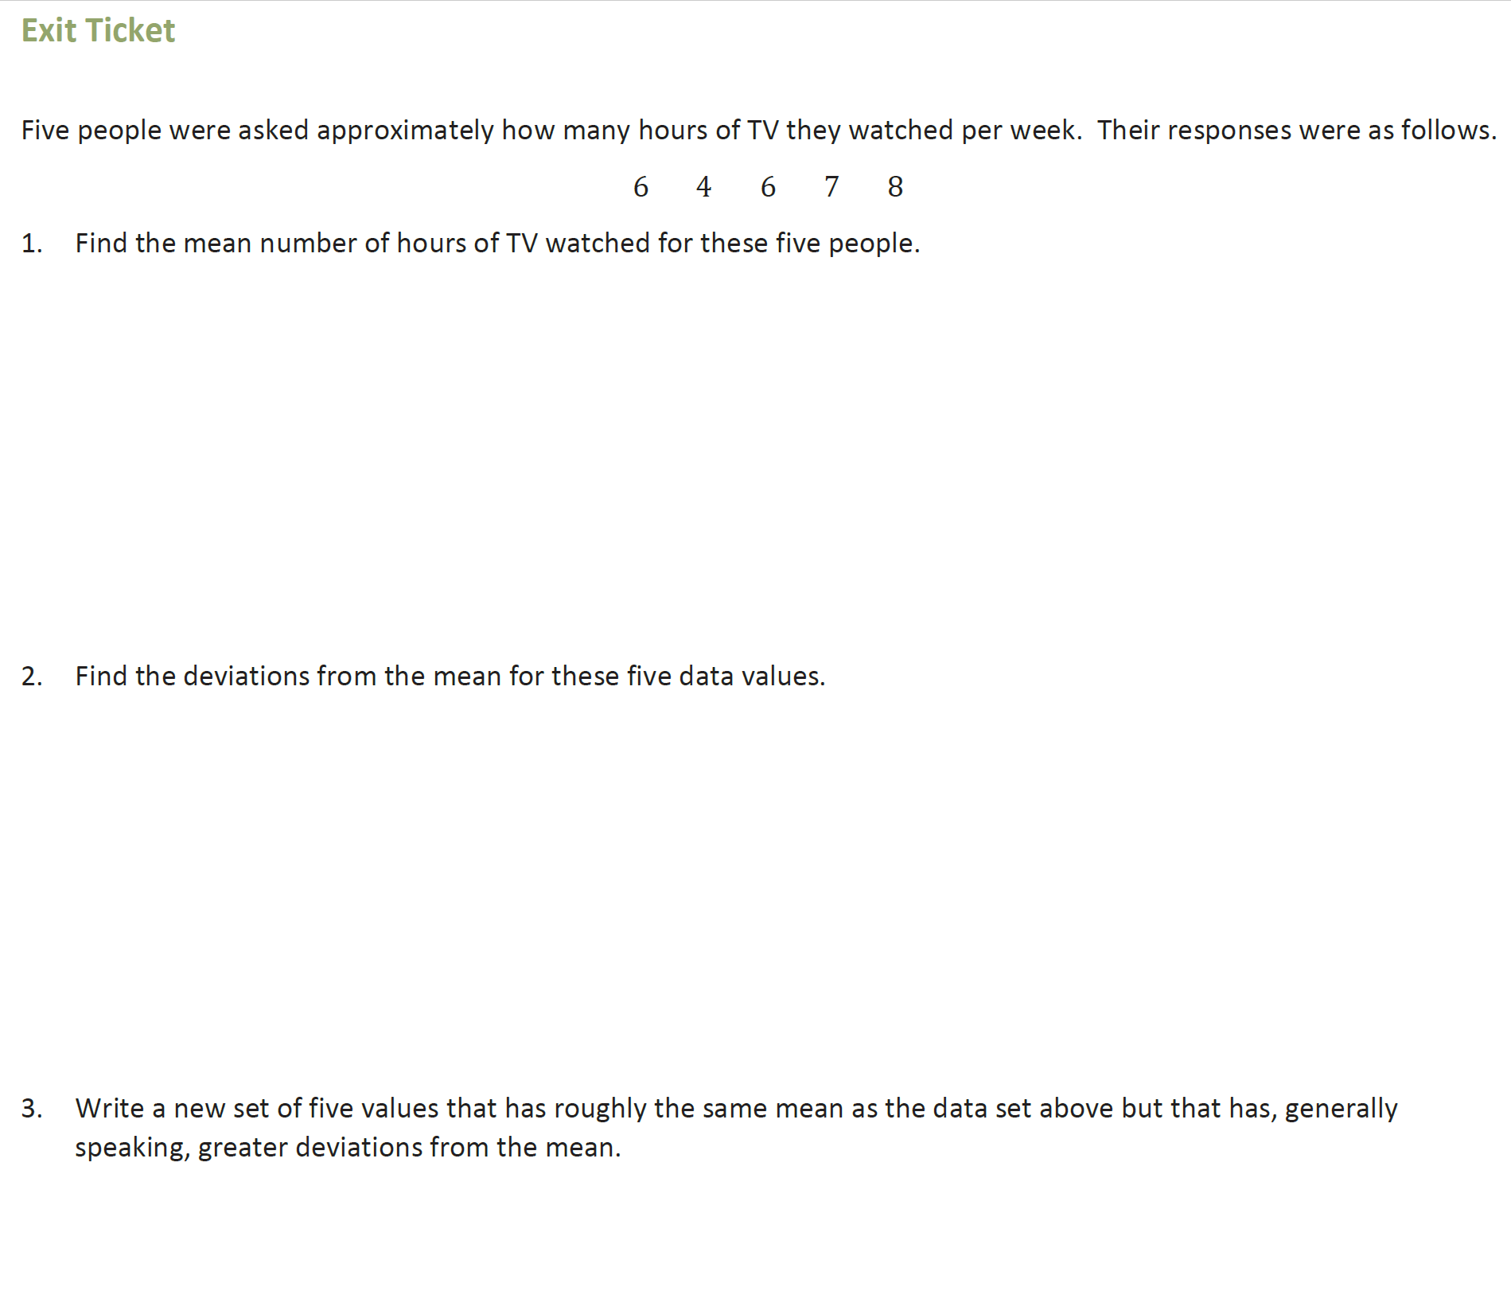

Slide 44
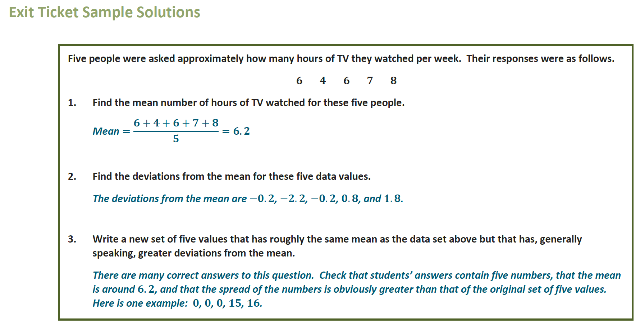

Slide 45
Assignment
Page 29-30

