Slide 1
Transport in plants

Slide 2
Why plants need transport systems?
Transport of water
Transport of mineral salts
Transport of organic food

Slide 3
There are two transport systems in plants
1) xylem vessel 木质部导管
  for carrying water and mineral salts
2) phloem tube 韧皮部筛管
  for carrying organic nutrients that the plant has made

Slide 4
Xylem vessels and phloem tubes are usually found close together.
A group of xylem vessels and phloem tubes is called a vascular bundle.
The positions of vascular bundles in roots, shoots and leaves are different.

Slide 5
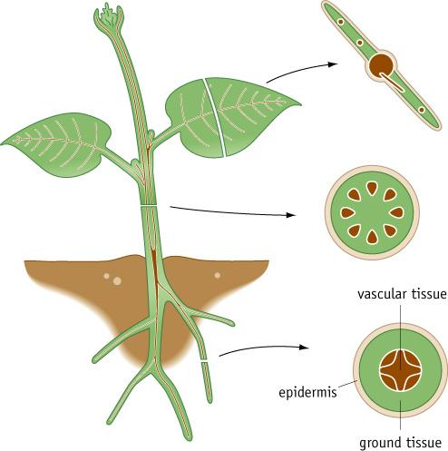
The vascular bundle

Slide 6
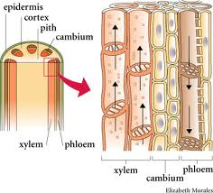

Slide 7
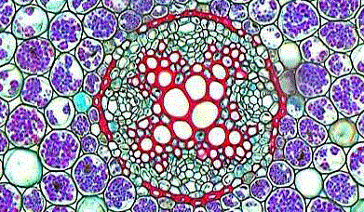
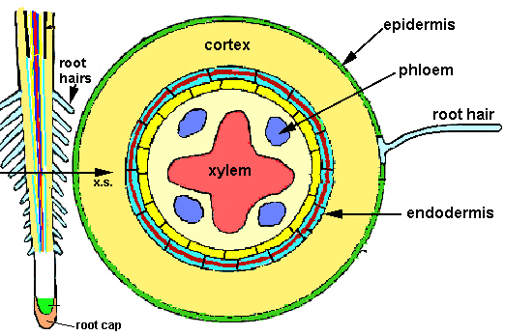
Vascular bundles in roots
xylem
phloem

Slide 8
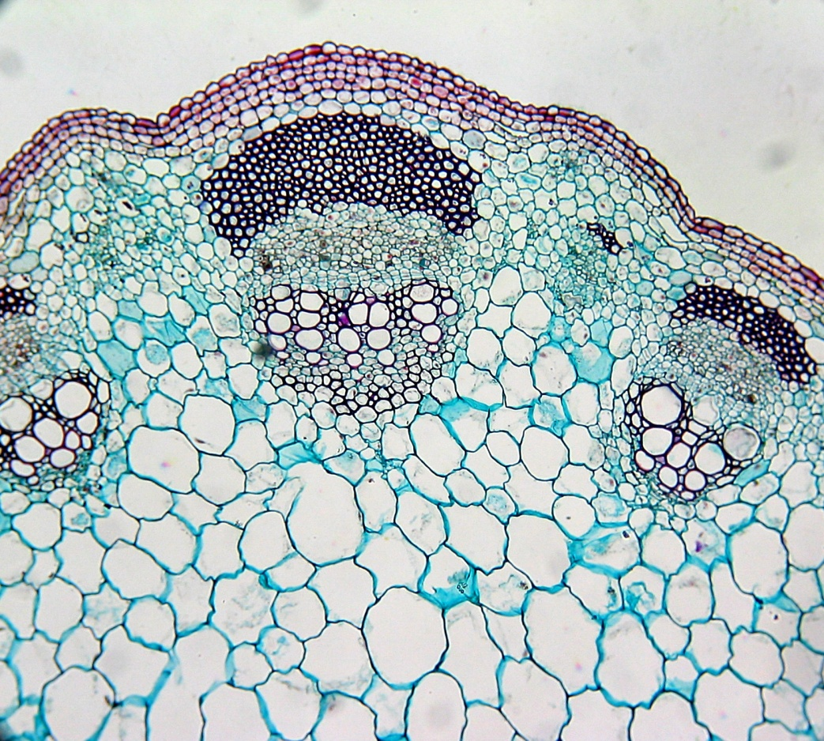
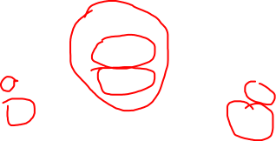
vascular bundle in stem
phloem
xylem

Slide 9
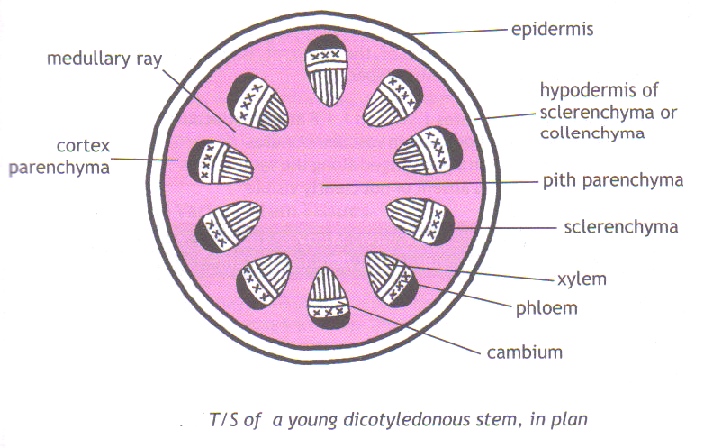

Slide 10

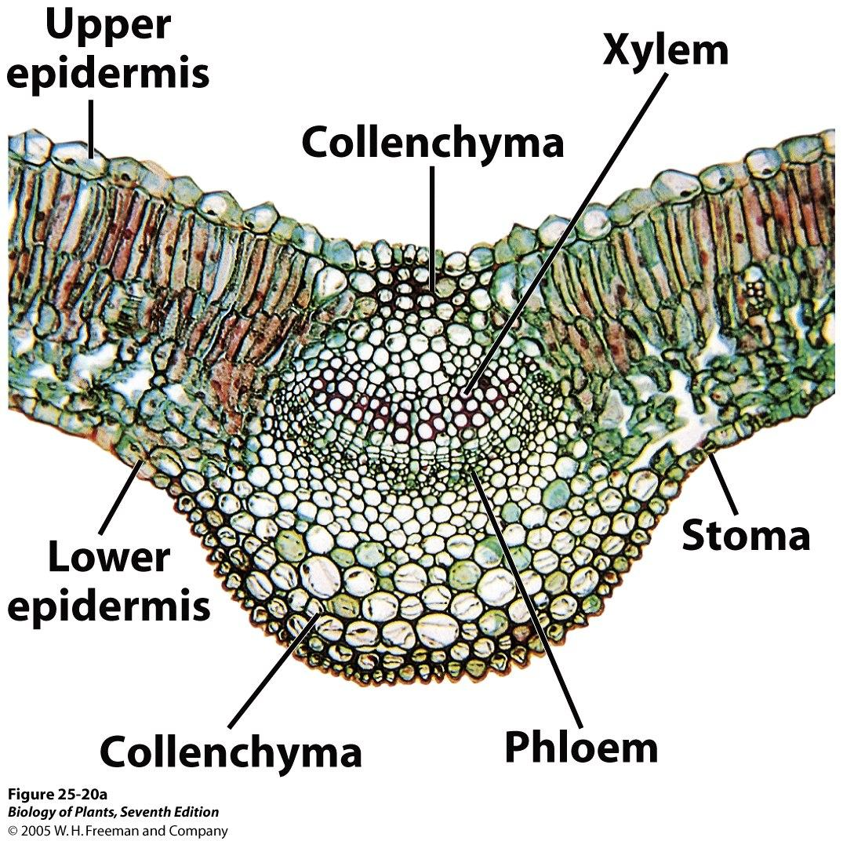
Vascular bundle in leaves

Slide 11
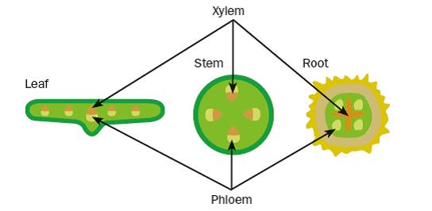

Slide 12
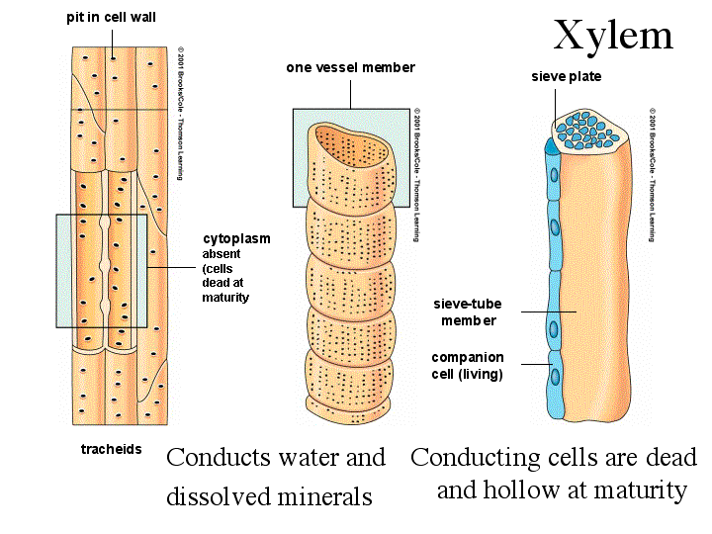
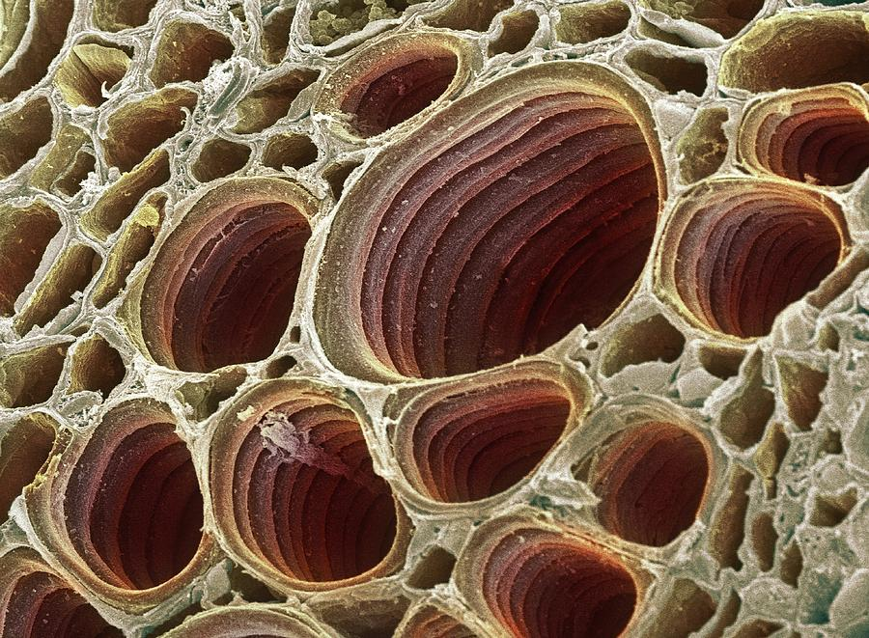
Xylem also helps to support plants
A xylem vessel is like a long drainpipe. It is made of many hollow, dead cells, joined end to end. The end wall of the cells have disappeared.
Xylem vessels contain no cytoplasm or nucleus . Their walls are made of cellulose and lignin . Lignin is very strong, so the xylem vessels can help to keep plants upright.

Slide 13
Phloem contains sieve tube elements.
Phloem tubes are also made of many cells joined end to end forming sieve plate. The cells are called sieve tube elements which contain cytoplasm , but no nucleus .
Each sieve tube element has a companion cell next to it. Companion cell has a nucleus. The function of companion cells is supplying sieve tube elements with some of their requirements.

Slide 14
Xylem
Hollow dead tubes
  Xylem vessels have no living contents – allows the water to flow freely inside.
  End walls are completely absent – this forms continuous tubes
Made of lignin
  Very strong so help support the plant
Transport water and minerals

Slide 15
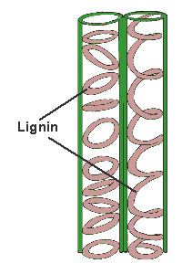
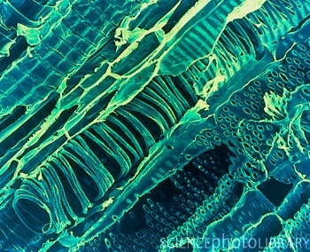

Slide 16
Phloem
Transports sugar around plant
Made of living cells
Companion cells provide the energy for the tube cells.
The end walls of the tube cells have pores through which food is transported from cell to cell in the form of dissolved sugars

Slide 17
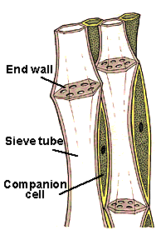
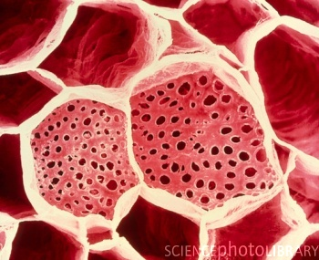

Slide 18
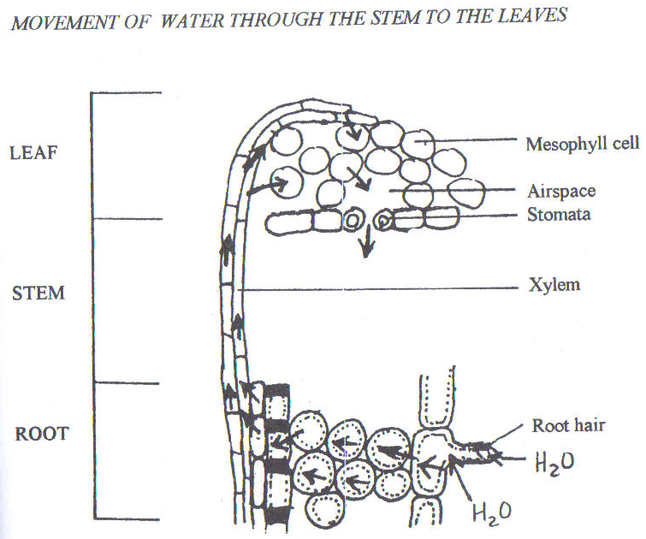

Slide 19
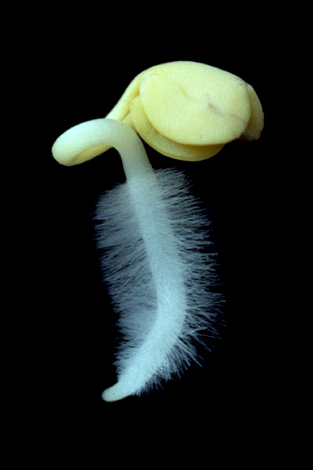
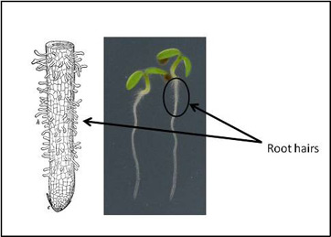
Root tip 根尖
Root cap 根冠: protect the root as it grows
through the soil.

Slide 20
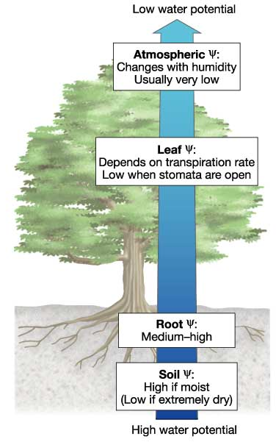
Water uptake
Water moves down a water potential gradient, from soil to the root hair , across to the xylem vessel , up to the leaves and then put into the air .

Slide 21
Water uptake
1) From soil to root hair:
  Water enters the root hair from the soil by osmosis.
2) From root hair to xylem:
  Water travels by osmosis through the cortex, from cell to cell. It also seeps through the spaces between the cells, or through the cell walls.
3) From xylem to leaf:
  Water moves up the root and stem in the xylem vessel.
4) From leaf to the atmosphere:
  Water evaporates from the leaves. (transpiration)

Slide 22
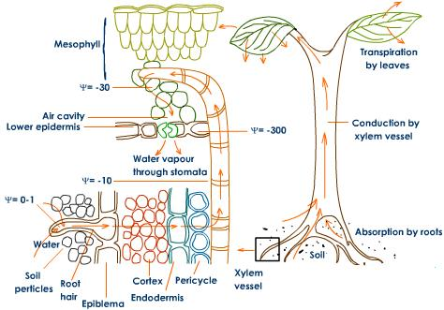

Slide 23
Transpiration
Definition of Transpiration:
Loss of water from plant leaves by evaporation of water at the surfaces of the mesophyll cells followed by loss of water vapour through the stomata.

Slide 24
Stomata
Tiny pores found on the surfaces of a leaf
Stomata take in carbon dioxide from the air through stomata
Water vapour passes out from the leaf to the atmosphere through stomata

Slide 25
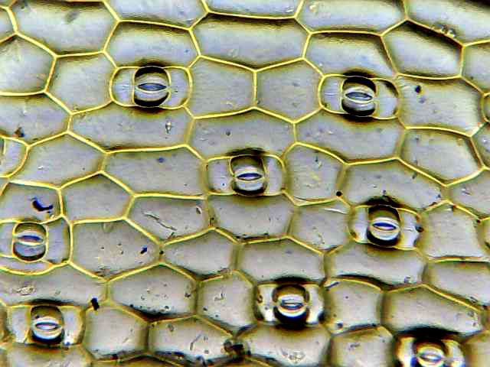
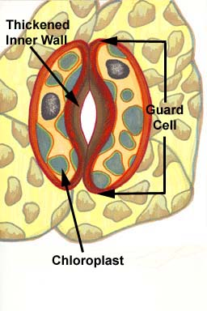

Slide 26
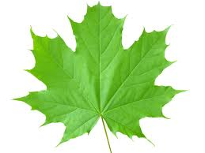
Leaf structure
midrib中脉
Margin叶缘
vein叶脉
lamina 叶片

Slide 27
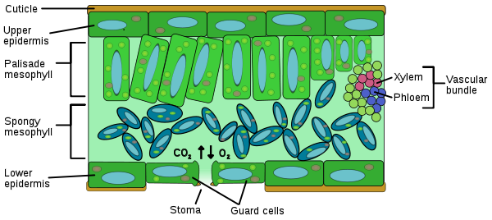
Transverse section of leave

Slide 28
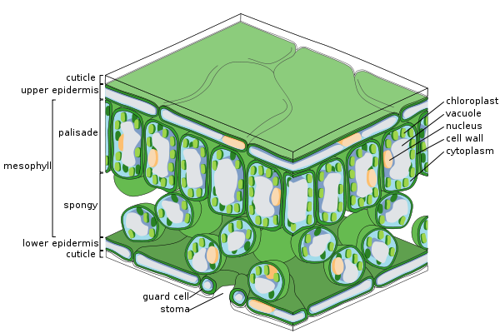

Slide 29
Cuticle: a waxy substance. The function is helping to stop water evaporating from the leaf.
Epidermis: do not contain chloroplasts. The function is to protect the inner layers of cells.
Mesophyll: the middle layers of the leaf. They contain chloroplasts. It can be divided into two layers:
  Palisade layer: near the top of the leaf, arranged as a fencer or palisade.
  Spongy layer: arranged loosely, with large air spaces.

Slide 30
Veins（vascular bundle）: running through the mesophyll. Each vein contains two parts:
  Xylem vessels: with large thick wall, its function is carrying water and minerals
  Phloem vessels: with smaller thin wall, its function is carrying away sucrose and other organic substances that the leaf has made.
Stomata: small openings in the lower epidermis. Each stoma is surrounded by a pair of sausage-shaped guard cells.
  Guard cell: open or close the hole. It contains chloroplasts. (page 51)

Slide 31
Leaves are adaptive for obtaining carbon dioxide, water and sunlight

Slide 32
Supported by stem and petiole: large surface exposed to light and air.
Thin: allow sunlight to penetrate through it, allow CO₂ and O₂ to diffuse as quickly as possible.
The transparent upper epidermis: allow sunlight to penetrate through it.
Air spaces in spongy layers: carbon dioxide and water move easily.
Lower epidermis is full of stomata: gas exchange
A network of veins: transport and support
Lots of chloroplasts in palisade layer: absorb light energy for photosynthesis.

Slide 33
Conditions that affect transpiration rate:
  Temperature:
    transpiration increases as temperature increases.
  Humidity:
    the higher the humidity, the less water will evaporate from the leaves.
  Wind speed:
    transpiration increase as wind speed increases.
  Light intensity:
    in a bright sunlight, a plant may open its stomata to supply plenty of carbon dioxide for photosynthesis. More water can therefore evaporate from the leaves.
  Water supply:
    transpiration decreases when water supply decreases below a certain level.

Slide 34

Transpiration
Advantages of Transpiration:
  Transpiration keeps water moving up the xylem vessels and evaporation helps to cool the leaves.
Disadvantages of transpiration:
  If the leaves lose too much water, the roots may not be able to take up enough to replace it. If it happens, the plant wilts, because the cells lose water by osmosis and become flaccid.

Slide 35
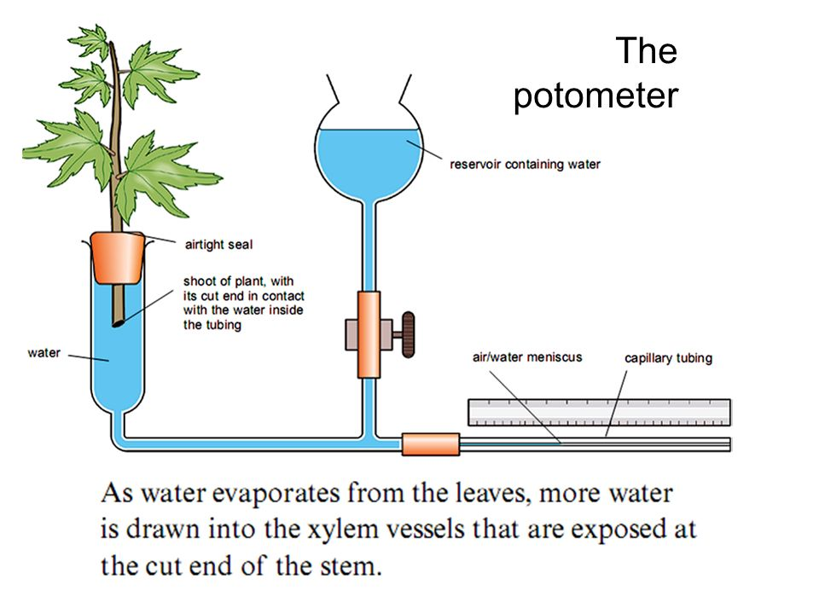
Potometer 蒸腾计
It is an apparatus can be used to compare the rate of transpiration in different conditions.

Slide 37
Mechanism of water uptake
Water enters root hair cells by osmosis. Water potential in the soil is higher than in the cell.
As water enters the cell, its water potential becomes higher than in the cell next to it, e.g. in the cortex. So water moves by osmosis into the next cell.
The process is repeated until water reaches the xylem.

Slide 38
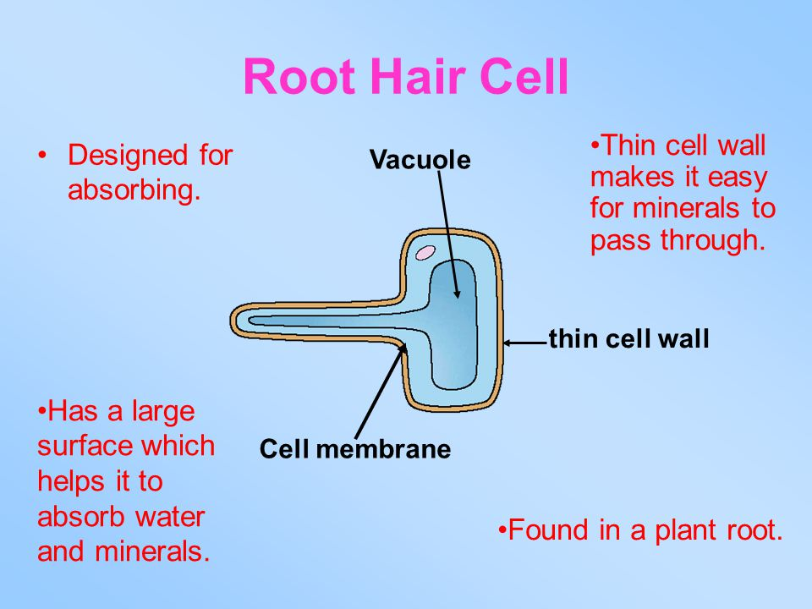
Enlarged Root Hair

Slide 39
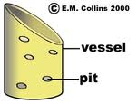
Water enters the xylem vessel through pits in walls.

Slide 40
Mechanism of water movement through a plant
Water vapor evaporating from a leaf ( transpiration ) creates a “pull” from above, creating a water potential gradient in the xylem, drawing water up the plant.
Water molecules are attracted to each other (cohesion), so more water is drawn up from the xylem.

Slide 41
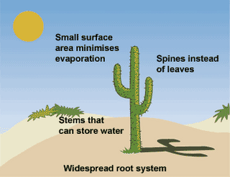
Adaptations of the leaf, stem and root in different environments
Desert plants must cut down water loss.
  They have several ways of cutting down the rate of water loss by respiration.
    Such as closing stomata, waxy cuticle, hairy leaves, stomata on underside of leaves, cutting down on the surface area and having deep or spreading roots.

Slide 42
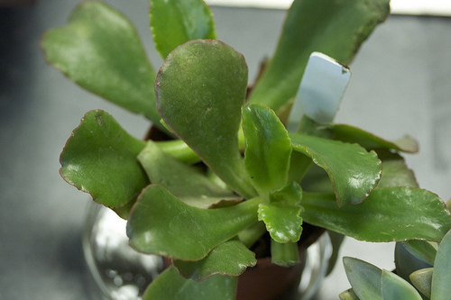
Thickened cuticle:
  A thick cuticle on the surface of leaves reduces the rate of transpiration.

Slide 43
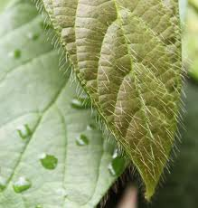
Hairy leaves:
  reduces transpiration. Hairs also trap water vapour, restricting water loss.

Slide 44
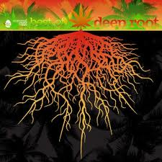
Deep and spreading roots:
  Increase water uptake

Slide 45
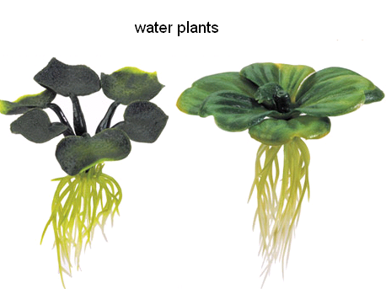
Water plants may have stomata on the tops of their leaves.
  They have no problem of water shortage. They have stomata on both surfaces. This allows them to absorb carbon dioxide from air for photosynthesis.

Slide 46
Uptake of mineral salts (xylem)
Mineral salts are absorbed by root by active transport. These are in the form of ions dissolved in the water in the soil.
They travel through the xylem vessel along with the water which is absorbed, and are transported to all parts of the plant.

Slide 47
Translocation (phloem)
Definition:
The movement of sucrose and amino acids in phloem, from regions of production (sources) to regions of storage, or to regions of utilisation in respiration or growth (sinks).

Slide 48
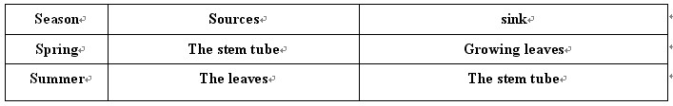
Sources and sinks vary with the seasons:

Slide 49
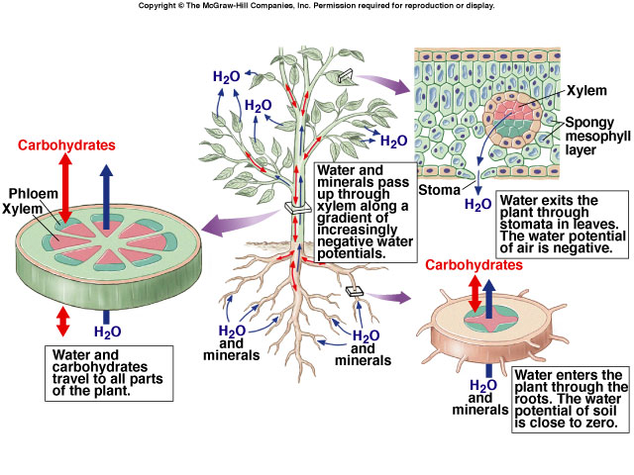

Slide 50
Phloem can transfer carbohydrate in either direction (up and down)
Xylem can only transfer water upwards.

