Slide 1
提问+quiz (canvas)
你的帆桨小船要从中国出发了，为了顺利的扬帆起航，请问你打算在几月的什么时候出航呢？
*什么时候
早上6点，顺顺顺
早上10点，十全十美
中午12点，阳气最浓，平安出航
下午2点，一天中最热紫外线最强的时刻
下午4点，海上喝个下午茶
晚上8点，海上日落
晚上11点，海上升明月

Slide 2
Cause of Wind
Earth is a sphere
Unequal warming of Earth’s surface
temperature gradients
Air movement (High pressure to low pressure)
pressure gradients
(ht, lp; lt, hp)
Wind: horizontal movement

Slide 3
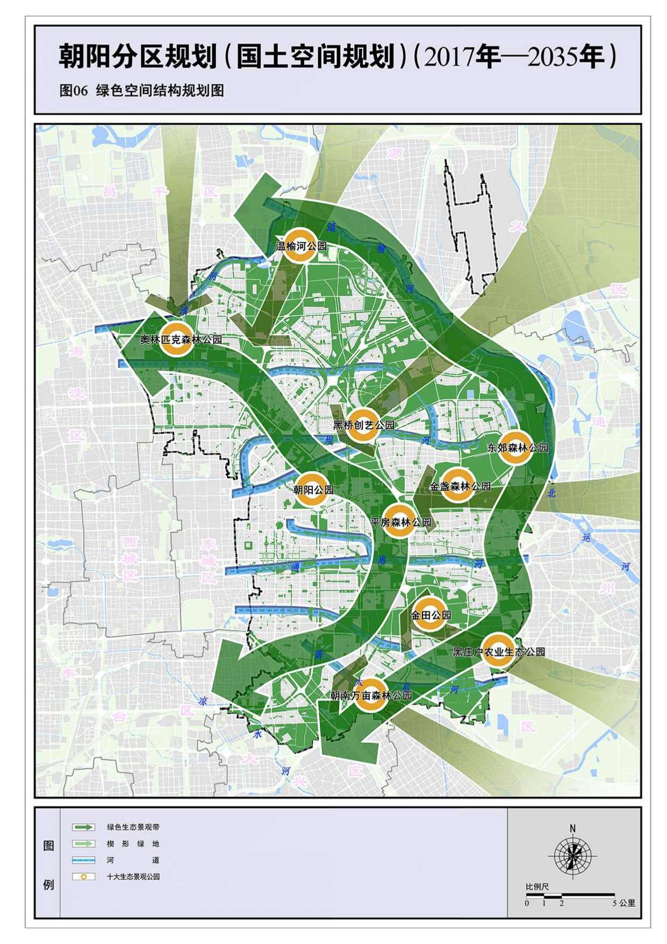
Homework feedback--Local Atmospheric Circulation
金启阳
Urban heat island effect
Urban & rural
Things absorb heat
Things release heat
Specific heat capacity of land and water

Slide 4
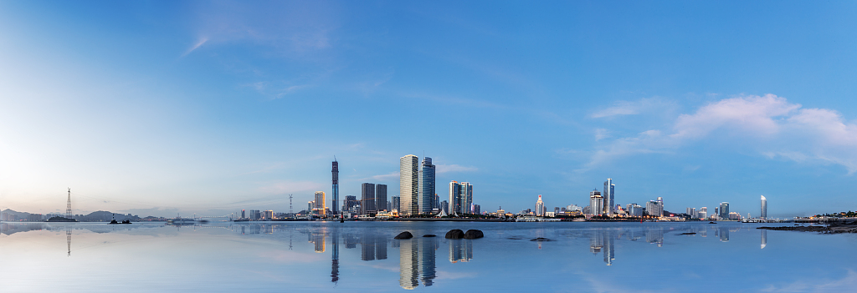
Urban Heat Island Effect 城市热岛效应
Trees (shade, block) + standing water (latent heating)
engines & cars (release waste heat 废热)+ buildings & road materials (absorb)
High pressure
Low pressure
Low pressure
Low pressure
high pressure
high pressure
High temperature
low temperature
low temperature

Slide 5
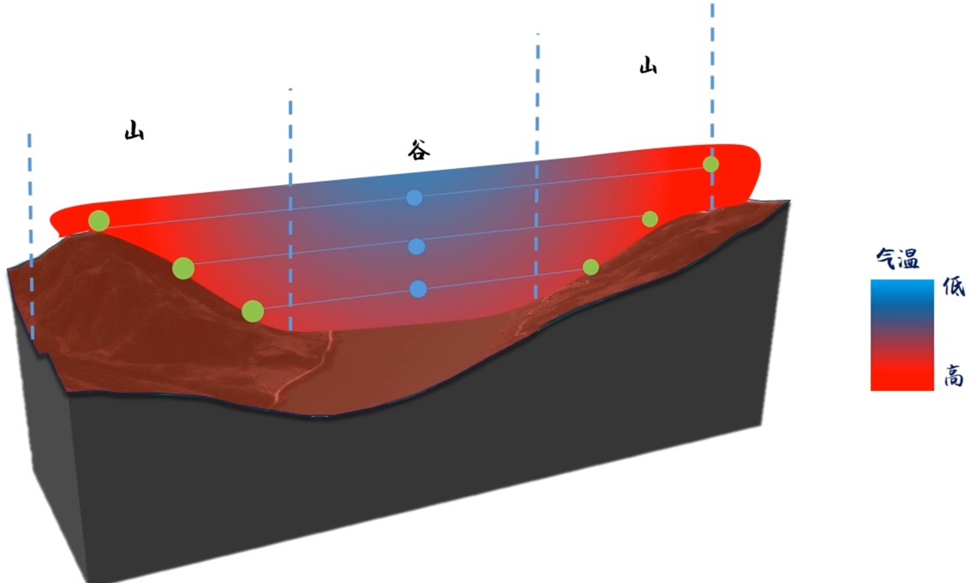

Slide 6
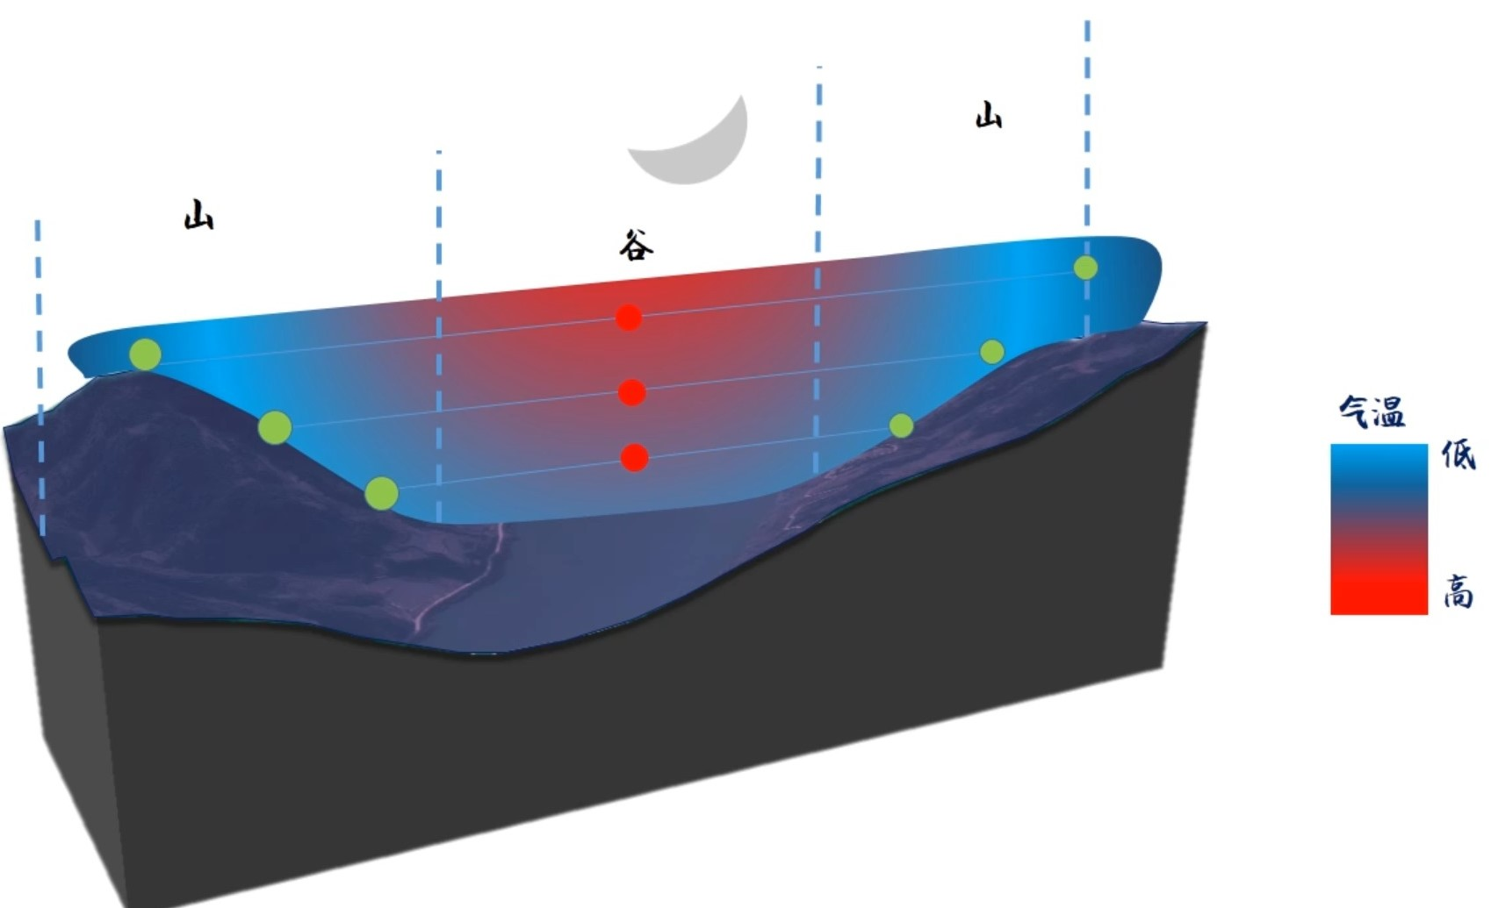

Slide 7
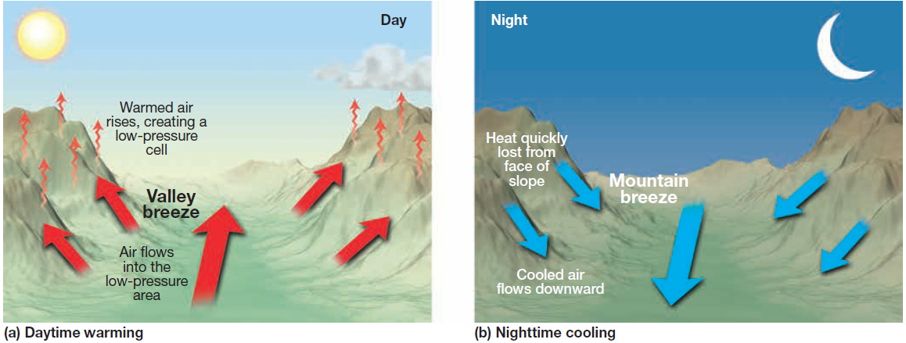
Valley breeze and Mountain breeze video

Slide 8
Local Atmospheric Circulation
The Sea Breeze (Daytime) & The Land Breeze (Nighttime)
Urban Heat Island
Valley Breeze (Daytime) & mountain breeze (Nighttime)
atmospheric pressure +
volume is constant
collision force
temperature
speed of molecules
volume is not constant
density --
wind is horizontal air moving from an area of high pressure toward an area of low pressure.
atmospheric pressure --
warm surface conditions are often associated with relatively low pressure at the surface—a thermal low.
cold surface conditions are often associated with high pressure at the surface—a thermal high.

Slide 9
wind direction
A
B
C
Ideal case
Upper atmosphere
Near surface

Slide 10
review
Pressure gradient force
Wind direction

Slide 11
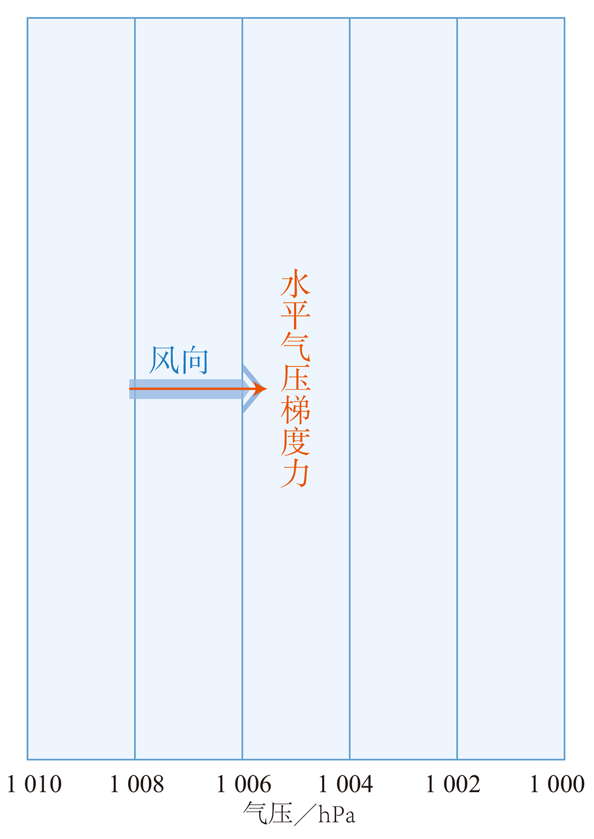
A · Pressure gradient force and wind direction
The pressure gradient force acts at right angles to the isobars in the direction of the lower pressure.
If there were no other factors to consider, that is the way the air would move, crossing the isobars at 90°.
图. 在水平气压梯度力作用下的风向

Slide 12
wind direction
A
B
C
Ideal case
Upper atmosphere
Near surface
Pressure Gradient Force

Slide 13
Direction?
Hemisphere?

Slide 14
The Coriolis Effect
Experiment 1: Does Water flow to different directions?
https://www.bilibili.com/video/BV19x411i7vD/
Water spins to the ________ (left/right) in the Northern hemisphere;
Water spins to the ________ (left/right) in the Southern hemisphere.
What causes the Coriolis Effect?
Experiment 2: Lab https://www.bilibili.com/video/BV1Wb411z7cD
A fast-moving object is deflected _____ (more/less) than a slower one.

Slide 15
Counterclockwise
Northern Hemisphere
Clockwise
Southern Hemisphere
The Coriolis Effect
Earth’s Rotation

Slide 16
wind direction
A
B
C
Ideal case
Upper atmosphere
Near surface
Pressure Gradient Force
Pressure Gradient Force
The Coriolis Effect

Slide 17
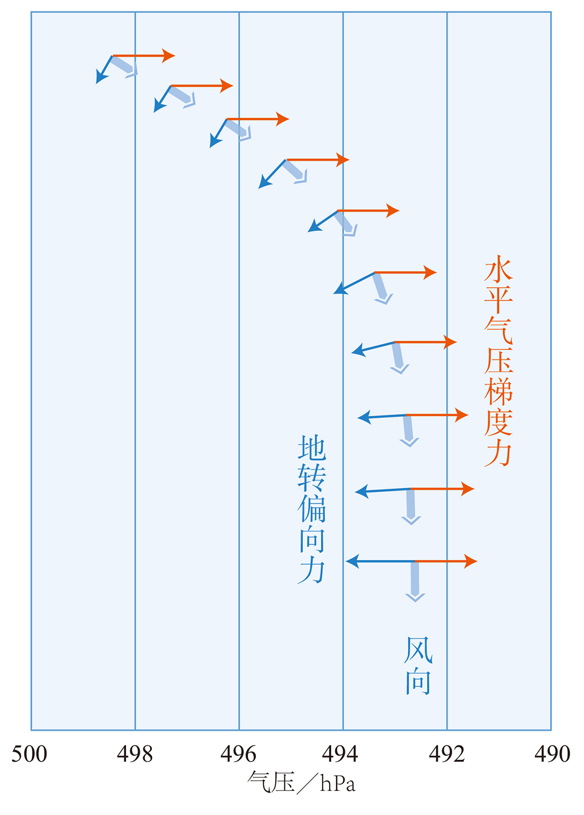
Upper atmosphere wind
B. pressure gradient & the Coriolis Effect
The Coriolis effect deflects any freely moving object to the right in the Northern Hemisphere as soon as wind forms.
The Coriolis effect only changes the direction of the wind, not the speed.
The wind moves parallel to the isobars in upper atmosphere.
图. 在水平气压梯度力和
地转偏向力共同作用下的风向(N高空)

Slide 18
wind direction
A
B
C
Ideal case
Upper atmosphere
Near surface
Pressure Gradient Force
Pressure Gradient Force
The Coriolis Effect
Pressure Gradient Force
The Coriolis Effect
Friction

Slide 19
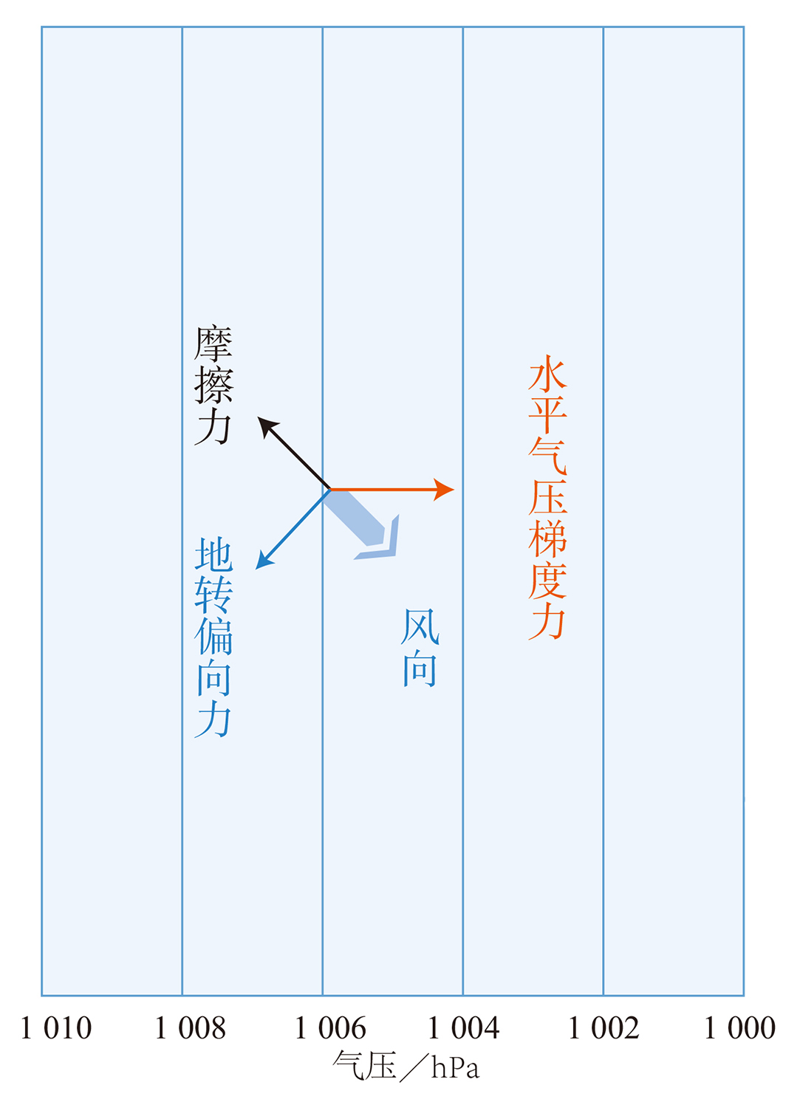
surface wind
C· pressure gradient, the Coriolis effect, and friction
Instead of blowing perpendicular to the isobars (along the pressure gradient) or parallel to them (where the pressure gradient force and the Coriolis effect balance), the wind gradually crosses the isobars at angles between 0° and 90°.
Friction reduces wind speed.
图. 在水平气压梯度力、地转偏向力和摩擦力共同作用下的风向(N近地面)

Slide 20
wind direction
A
B
C
Ideal case
Upper atmosphere
Near surface
Pressure Gradient Force
Pressure Gradient Force
The Coriolis Effect
Pressure Gradient Force
The Coriolis Effect
Friction

